Slide 1
SOA Exam FM
Module 3 – Section 3
Level Payment Amortization Table

Slide 2


$$Example$$
A 4-year loan of 1000 at an annual effective interest rate of 4% is repaid with level annual payments. Determine $C$, the amount of each payment.

Slide 3
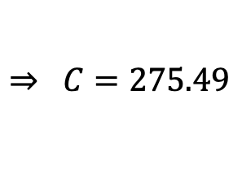

$$Example$$
A 4-year loan of 1000 at an annual effective interest rate of 4% is repaid with level annual payments. Determine $C$, the amount of each payment.
$$1000=Ca_{\overline{4}|0.04}$$
$$⇒ C=275.49$$

Slide 4






$$Example$$
A 4-year loan of 1000 at an annual effective interest rate of 4% is repaid with level annual payments. Determine $C$, the amount of each payment.
$$1000=Ca_{\overline{4}|0.04}$$
$$⇒ C=275.49$$
$$275.49$$
$$275.49$$
$$275.49$$
$$275.49$$
$$1$$
$$2$$
$$3$$
$$4$$
$$L=1000$$

Slide 5


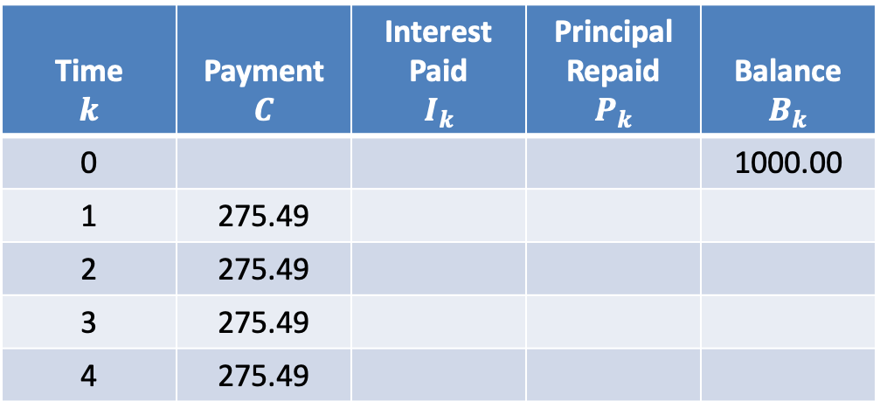
$$Amortization Table$$
$$i=0.04$$
Time $$k$$ | Payment $$C$$ | Interest Paid $$I_{k}$$ | Principal Repaid $$P_{k}$$ | Balance $$B_{k}$$
0 |  |  |  | 1000.00
1 | 275.49
2 | 275.49
3 | 275.49
4 | 275.49

Slide 6

$$Amortization Table$$
$$i=0.04$$
Time $$k$$ | Payment $$C$$ | Interest Paid $$I_{k}$$ | Principal Repaid $$P_{k}$$ | Balance $$B_{k}$$
0 |  |  |  | 1000.00
1 | 275.49
2 | 275.49
3 | 275.49
4 | 275.49
$$I_{1}=0.04∙1000$$

Slide 7

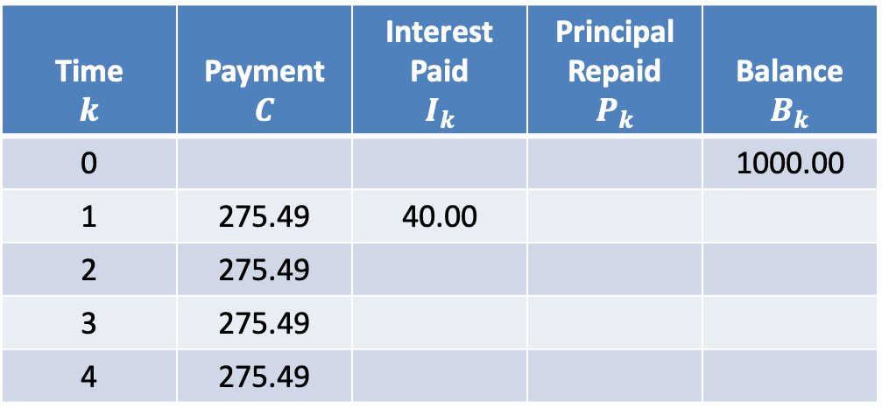
$$Amortization Table$$
$$i=0.04$$
Time $$k$$ | Payment $$C$$ | Interest Paid $$I_{k}$$ | Principal Repaid $$P_{k}$$ | Balance $$B_{k}$$
0 |  |  |  | 1000.00
1 | 275.49 | 40.00
2 | 275.49
3 | 275.49
4 | 275.49
$$I_{1}=0.04∙1000$$
$$=40.00$$

Slide 8

$$Amortization Table$$
$$i=0.04$$
Time $$k$$ | Payment $$C$$ | Interest Paid $$I_{k}$$ | Principal Repaid $$P_{k}$$ | Balance $$B_{k}$$
0 |  |  |  | 1000.00
1 | 275.49 | 40.00
2 | 275.49
3 | 275.49
4 | 275.49
$$I_{1}=0.04∙1000$$
$$=40.00$$
$$P_{1}=275.49−40.00$$

Slide 9
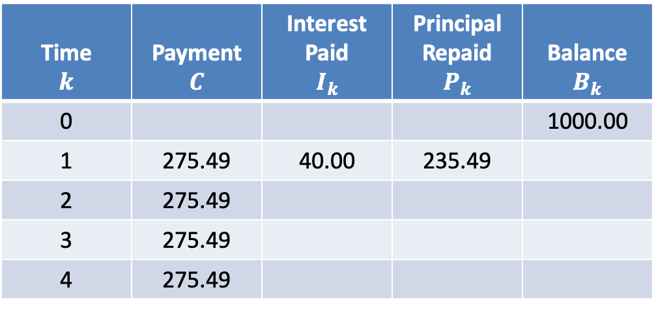

$$Amortization Table$$
$$i=0.04$$
Time $$k$$ | Payment $$C$$ | Interest Paid $$I_{k}$$ | Principal Repaid $$P_{k}$$ | Balance $$B_{k}$$
0 |  |  |  | 1000.00
1 | 275.49 | 40.00 | 235.49
2 | 275.49
3 | 275.49
4 | 275.49
$$I_{1}=0.04∙1000$$
$$=40.00$$
$$P_{1}=275.49−40.00$$
$$=235.49$$

Slide 10

$$Amortization Table$$
$$i=0.04$$
Time $$k$$ | Payment $$C$$ | Interest Paid $$I_{k}$$ | Principal Repaid $$P_{k}$$ | Balance $$B_{k}$$
0 |  |  |  | 1000.00
1 | 275.49 | 40.00 | 235.49
2 | 275.49
3 | 275.49
4 | 275.49
$$I_{1}=0.04∙1000$$
$$=40.00$$
$$P_{1}=275.49−40.00$$
$$=235.49$$
$$B_{1}=1000.00−235.49$$

Slide 11

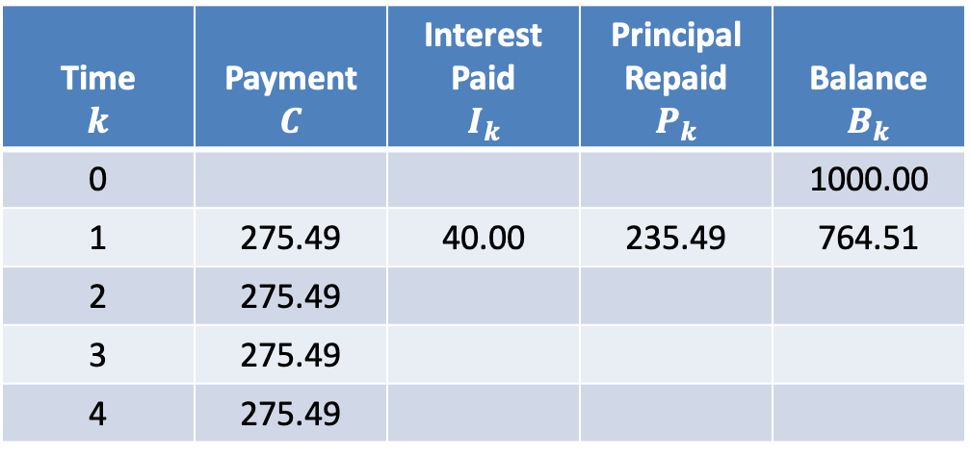
$$Amortization Table$$
$$i=0.04$$
Time $$k$$ | Payment $$C$$ | Interest Paid $$I_{k}$$ | Principal Repaid $$P_{k}$$ | Balance $$B_{k}$$
0 |  |  |  | 1000.00
1 | 275.49 | 40.00 | 235.49 | 764.51
2 | 275.49
3 | 275.49
4 | 275.49
$$I_{1}=0.04∙1000$$
$$=40.00$$
$$P_{1}=275.49−40.00$$
$$=235.49$$
$$B_{1}=1000.00−235.49$$
$$=764.51$$

Slide 12

$$Amortization Table$$
$$i=0.04$$
Time $$k$$ | Payment $$C$$ | Interest Paid $$I_{k}$$ | Principal Repaid $$P_{k}$$ | Balance $$B_{k}$$
0 |  |  |  | 1000.00
1 | 275.49 | 40.00 | 235.49 | 764.51
2 | 275.49
3 | 275.49
4 | 275.49
$$I_{2}=0.04∙764.51$$

Slide 13

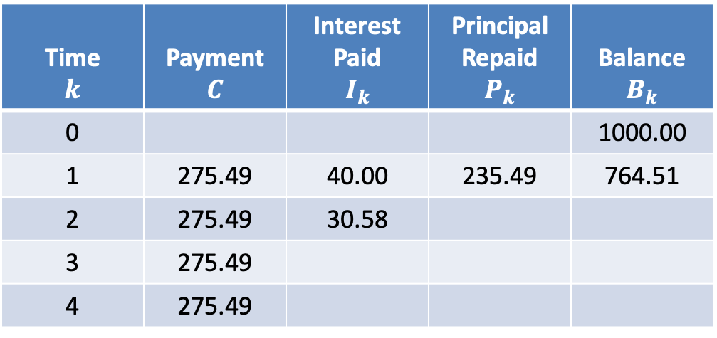
$$Amortization Table$$
$$i=0.04$$
Time $$k$$ | Payment $$C$$ | Interest Paid $$I_{k}$$ | Principal Repaid $$P_{k}$$ | Balance $$B_{k}$$
0 |  |  |  | 1000.00
1 | 275.49 | 40.00 | 235.49 | 764.51
2 | 275.49 | 30.58
3 | 275.49
4 | 275.49
$$I_{2}=0.04∙764.51$$
$$=30.58$$

Slide 14

$$Amortization Table$$
$$i=0.04$$
Time $$k$$ | Payment $$C$$ | Interest Paid $$I_{k}$$ | Principal Repaid $$P_{k}$$ | Balance $$B_{k}$$
0 |  |  |  | 1000.00
1 | 275.49 | 40.00 | 235.49 | 764.51
2 | 275.49 | 30.58
3 | 275.49
4 | 275.49
$$I_{2}=0.04∙764.51$$
$$=30.58$$
$$P_{2}=275.49−30.58$$

Slide 15
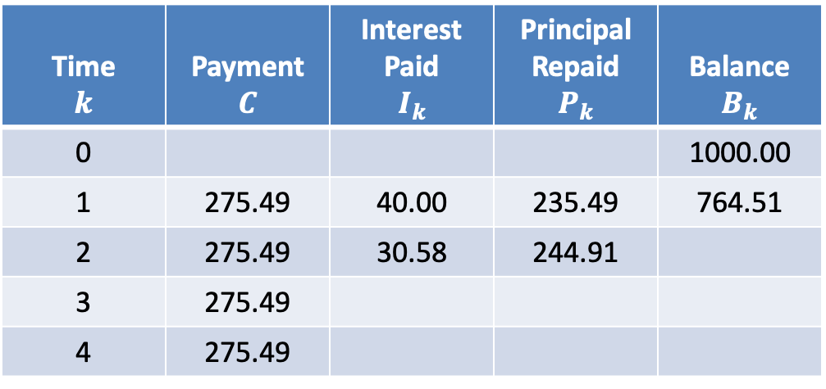

$$Amortization Table$$
$$i=0.04$$
Time $$k$$ | Payment $$C$$ | Interest Paid $$I_{k}$$ | Principal Repaid $$P_{k}$$ | Balance $$B_{k}$$
0 |  |  |  | 1000.00
1 | 275.49 | 40.00 | 235.49 | 764.51
2 | 275.49 | 30.58 | 244.91
3 | 275.49
4 | 275.49
$$I_{2}=0.04∙764.51$$
$$=30.58$$
$$P_{2}=275.49−30.58$$
$$=244.91$$

Slide 16

$$Amortization Table$$
$$i=0.04$$
Time $$k$$ | Payment $$C$$ | Interest Paid $$I_{k}$$ | Principal Repaid $$P_{k}$$ | Balance $$B_{k}$$
0 |  |  |  | 1000.00
1 | 275.49 | 40.00 | 235.49 | 764.51
2 | 275.49 | 30.58 | 244.91
3 | 275.49
4 | 275.49
$$I_{2}=0.04∙764.51$$
$$=30.58$$
$$P_{2}=275.49−30.58$$
$$=244.91$$
$$B_{2}=764.51−244.91$$

Slide 17

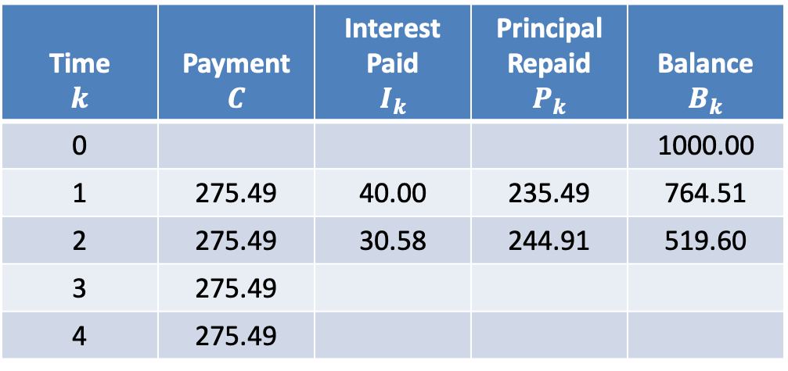
$$Amortization Table$$
$$i=0.04$$
Time $$k$$ | Payment $$C$$ | Interest Paid $$I_{k}$$ | Principal Repaid $$P_{k}$$ | Balance $$B_{k}$$
0 |  |  |  | 1000.00
1 | 275.49 | 40.00 | 235.49 | 764.51
2 | 275.49 | 30.58 | 244.91 | 519.60
3 | 275.49
4 | 275.49
$$I_{2}=0.04∙764.51$$
$$=30.58$$
$$P_{2}=275.49−30.58$$
$$=244.91$$
$$B_{2}=764.51−244.91$$
$$=519.60$$

Slide 18

$$Amortization Table$$
$$i=0.04$$
Time $$k$$ | Payment $$C$$ | Interest Paid $$I_{k}$$ | Principal Repaid $$P_{k}$$ | Balance $$B_{k}$$
0 |  |  |  | 1000.00
1 | 275.49 | 40.00 | 235.49 | 764.51
2 | 275.49 | 30.58 | 244.91 | 519.60
3 | 275.49
4 | 275.49
$$I_{3}=0.04∙519.40$$

Slide 19

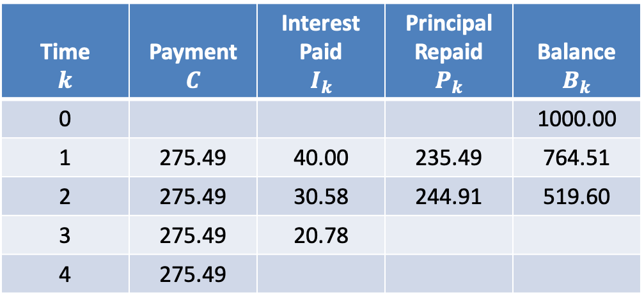
$$Amortization Table$$
$$i=0.04$$
Time $$k$$ | Payment $$C$$ | Interest Paid $$I_{k}$$ | Principal Repaid $$P_{k}$$ | Balance $$B_{k}$$
0 |  |  |  | 1000.00
1 | 275.49 | 40.00 | 235.49 | 764.51
2 | 275.49 | 30.58 | 244.91 | 519.60
3 | 275.49 | 20.78
4 | 275.49
$$I_{3}=0.04∙519.40$$
$$=20.78$$

Slide 20

$$Amortization Table$$
$$i=0.04$$
Time $$k$$ | Payment $$C$$ | Interest Paid $$I_{k}$$ | Principal Repaid $$P_{k}$$ | Balance $$B_{k}$$
0 |  |  |  | 1000.00
1 | 275.49 | 40.00 | 235.49 | 764.51
2 | 275.49 | 30.58 | 244.91 | 519.60
3 | 275.49 | 20.78
4 | 275.49
$$I_{3}=0.04∙519.40$$
$$=20.78$$
$$P_{3}=275.49−20.78$$

Slide 21
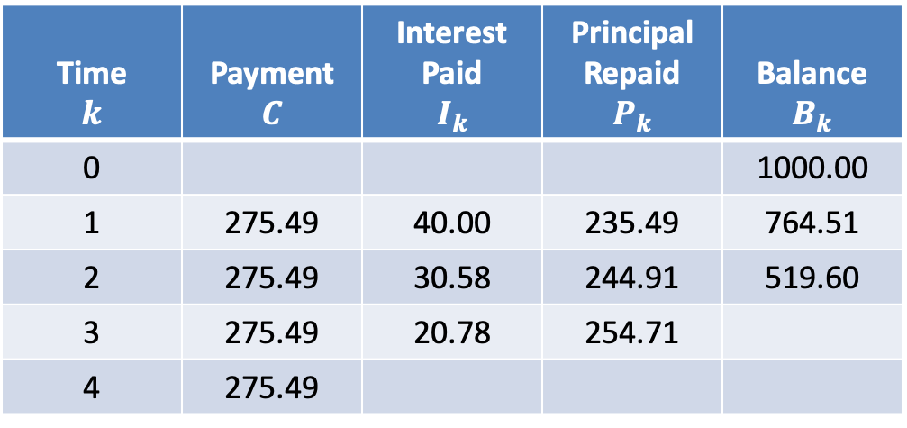

$$Amortization Table$$
$$i=0.04$$
Time $$k$$ | Payment $$C$$ | Interest Paid $$I_{k}$$ | Principal Repaid $$P_{k}$$ | Balance $$B_{k}$$
0 |  |  |  | 1000.00
1 | 275.49 | 40.00 | 235.49 | 764.51
2 | 275.49 | 30.58 | 244.91 | 519.60
3 | 275.49 | 20.78 | 254.71
4 | 275.49
$$I_{3}=0.04∙519.40$$
$$=20.78$$
$$P_{3}=275.49−20.78$$
$$=254.71$$

Slide 22

$$Amortization Table$$
$$i=0.04$$
Time $$k$$ | Payment $$C$$ | Interest Paid $$I_{k}$$ | Principal Repaid $$P_{k}$$ | Balance $$B_{k}$$
0 |  |  |  | 1000.00
1 | 275.49 | 40.00 | 235.49 | 764.51
2 | 275.49 | 30.58 | 244.91 | 519.60
3 | 275.49 | 20.78 | 254.71
4 | 275.49
$$I_{3}=0.04∙519.40$$
$$=20.78$$
$$P_{3}=275.49−20.78$$
$$=254.71$$
$$B_{3}=519.60−254.71$$

Slide 23

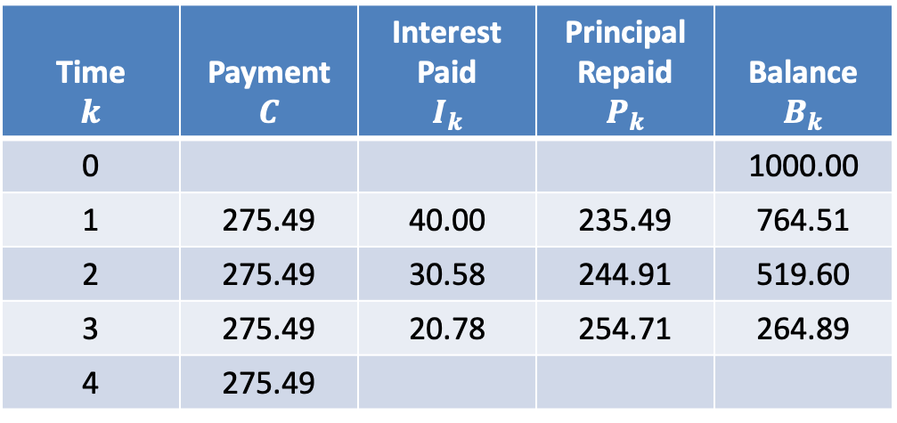
$$Amortization Table$$
$$i=0.04$$
Time $$k$$ | Payment $$C$$ | Interest Paid $$I_{k}$$ | Principal Repaid $$P_{k}$$ | Balance $$B_{k}$$
0 |  |  |  | 1000.00
1 | 275.49 | 40.00 | 235.49 | 764.51
2 | 275.49 | 30.58 | 244.91 | 519.60
3 | 275.49 | 20.78 | 254.71 | 264.89
4 | 275.49
$$I_{3}=0.04∙519.40$$
$$=20.78$$
$$P_{3}=275.49−20.78$$
$$=254.71$$
$$B_{3}=519.60−254.71$$
$$=264.89$$

Slide 24

$$Amortization Table$$
$$i=0.04$$
Time $$k$$ | Payment $$C$$ | Interest Paid $$I_{k}$$ | Principal Repaid $$P_{k}$$ | Balance $$B_{k}$$
0 |  |  |  | 1000.00
1 | 275.49 | 40.00 | 235.49 | 764.51
2 | 275.49 | 30.58 | 244.91 | 519.60
3 | 275.49 | 20.78 | 254.71 | 264.89
4 | 275.49
$$I_{4}=0.04∙246.89$$

Slide 25

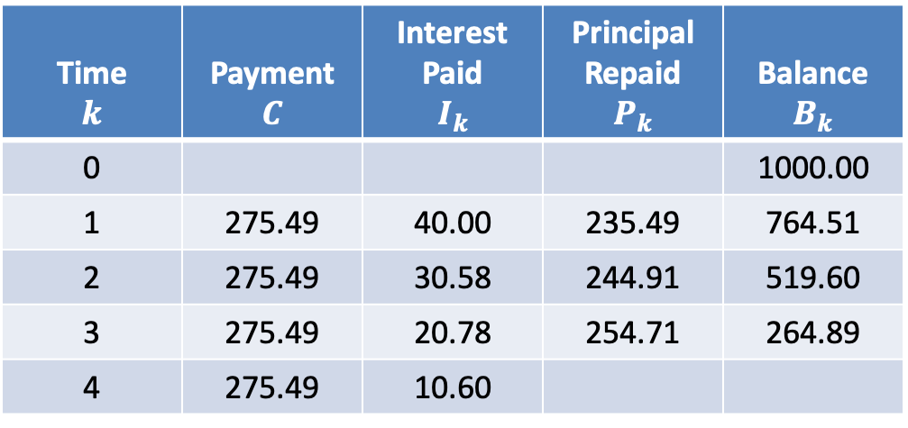
$$Amortization Table$$
$$i=0.04$$
Time $$k$$ | Payment $$C$$ | Interest Paid $$I_{k}$$ | Principal Repaid $$P_{k}$$ | Balance $$B_{k}$$
0 |  |  |  | 1000.00
1 | 275.49 | 40.00 | 235.49 | 764.51
2 | 275.49 | 30.58 | 244.91 | 519.60
3 | 275.49 | 20.78 | 254.71 | 264.89
4 | 275.49 | 10.60
$$I_{4}=0.04∙246.89$$
$$=10.60$$

Slide 26

$$Amortization Table$$
$$i=0.04$$
Time $$k$$ | Payment $$C$$ | Interest Paid $$I_{k}$$ | Principal Repaid $$P_{k}$$ | Balance $$B_{k}$$
0 |  |  |  | 1000.00
1 | 275.49 | 40.00 | 235.49 | 764.51
2 | 275.49 | 30.58 | 244.91 | 519.60
3 | 275.49 | 20.78 | 254.71 | 264.89
4 | 275.49 | 10.60
$$I_{4}=0.04∙246.89$$
$$=10.60$$
$$P_{4}=275.49−10.60$$

Slide 27
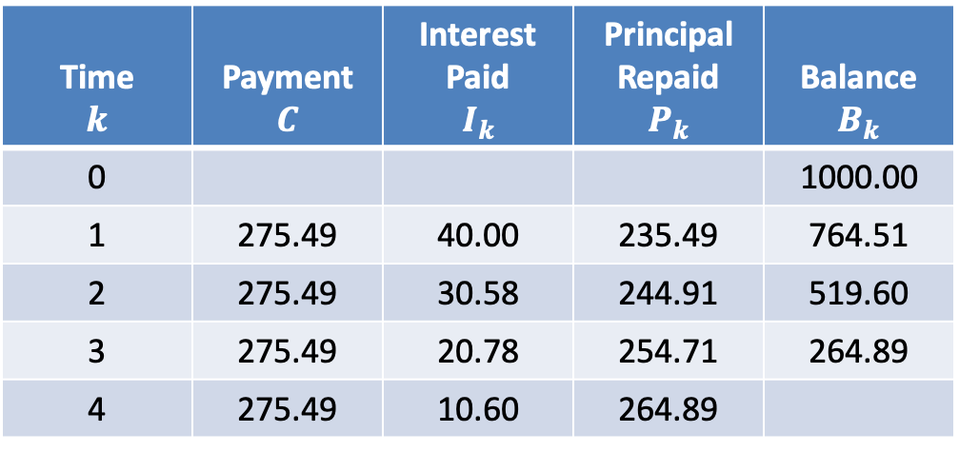

$$Amortization Table$$
$$i=0.04$$
Time $$k$$ | Payment $$C$$ | Interest Paid $$I_{k}$$ | Principal Repaid $$P_{k}$$ | Balance $$B_{k}$$
0 |  |  |  | 1000.00
1 | 275.49 | 40.00 | 235.49 | 764.51
2 | 275.49 | 30.58 | 244.91 | 519.60
3 | 275.49 | 20.78 | 254.71 | 264.89
4 | 275.49 | 10.60 | 264.89
$$I_{4}=0.04∙246.89$$
$$=10.60$$
$$P_{4}=275.49−10.60$$
$$=264.89$$

Slide 28

$$Amortization Table$$
$$i=0.04$$
Time $$k$$ | Payment $$C$$ | Interest Paid $$I_{k}$$ | Principal Repaid $$P_{k}$$ | Balance $$B_{k}$$
0 |  |  |  | 1000.00
1 | 275.49 | 40.00 | 235.49 | 764.51
2 | 275.49 | 30.58 | 244.91 | 519.60
3 | 275.49 | 20.78 | 254.71 | 264.89
4 | 275.49 | 10.60 | 264.89
$$I_{4}=0.04∙246.89$$
$$=10.60$$
$$P_{4}=275.49−10.60$$
$$=264.89$$
$$B_{4}=264.89−264.89$$

Slide 29

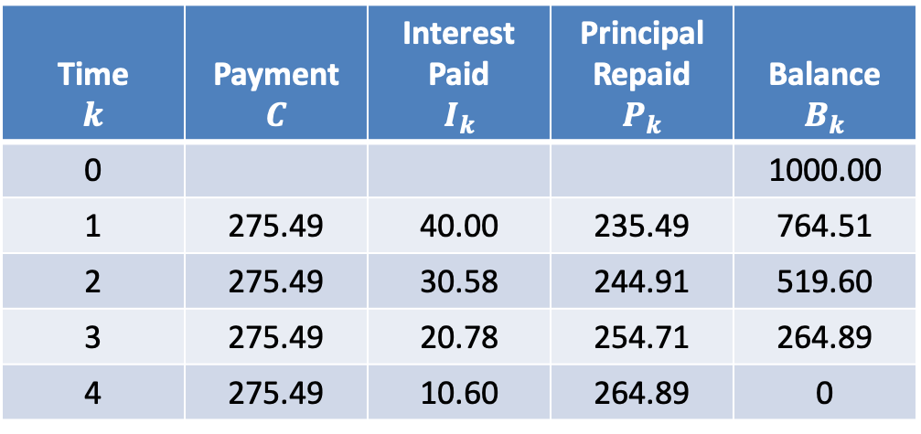
$$Amortization Table$$
$$i=0.04$$
Time $$k$$ | Payment $$C$$ | Interest Paid $$I_{k}$$ | Principal Repaid $$P_{k}$$ | Balance $$B_{k}$$
0 |  |  |  | 1000.00
1 | 275.49 | 40.00 | 235.49 | 764.51
2 | 275.49 | 30.58 | 244.91 | 519.60
3 | 275.49 | 20.78 | 254.71 | 264.89
4 | 275.49 | 10.60 | 264.89 | 0
$$I_{4}=0.04∙246.89$$
$$=10.60$$
$$P_{4}=275.49−10.60$$
$$=264.89$$
$$B_{4}=264.89−264.89$$
$$=0$$

Slide 30
$$Amortization Table$$
$$i=0.04$$
Time $$k$$ | Payment $$C$$ | Interest Paid $$I_{k}$$ | Principal Repaid $$P_{k}$$ | Balance $$B_{k}$$
0 |  |  |  | 1000.00
1 | 275.49 | 40.00 | 235.49 | 764.51
2 | 275.49 | 30.58 | 244.91 | 519.60
3 | 275.49 | 20.78 | 254.71 | 264.89
4 | 275.49 | 10.60 | 264.89 | 0

Slide 31

$$Amortization Table$$
$$i=0.04$$
Time $$k$$ | Payment $$C$$ | Interest Paid $$I_{k}$$ | Principal Repaid $$P_{k}$$ | Balance $$B_{k}$$
0 |  |  |  | 1000.00
1 | 275.49 | 40.00 | 235.49 | 764.51
2 | 275.49 | 30.58 | 244.91 | 519.60
3 | 275.49 | 20.78 | 254.71 | 264.89
4 | 275.49 | 10.60 | 264.89 | 0
$$Σ=1000$$

Slide 32

$$Amortization Table$$
$$i=0.04$$
Time $$k$$ | Payment $$C$$ | Interest Paid $$I_{k}$$ | Principal Repaid $$P_{k}$$ | Balance $$B_{k}$$
0 |  |  |  | 1000.00
1 | 275.49 | 40.00 | 235.49 | 764.51
2 | 275.49 | 30.58 | 244.91 | 519.60
3 | 275.49 | 20.78 | 254.71 | 264.89
4 | 275.49 | 10.60 | 264.89 | 0
$$\frac{244.91}{235.49}=1.04$$

Slide 33

$$Amortization Table$$
$$i=0.04$$
Time $$k$$ | Payment $$C$$ | Interest Paid $$I_{k}$$ | Principal Repaid $$P_{k}$$ | Balance $$B_{k}$$
0 |  |  |  | 1000.00
1 | 275.49 | 40.00 | 235.49 | 764.51
2 | 275.49 | 30.58 | 244.91 | 519.60
3 | 275.49 | 20.78 | 254.71 | 264.89
4 | 275.49 | 10.60 | 264.89 | 0
$$\frac{244.91}{235.49}=1.04$$
$$\frac{254.71}{244.91}=1.04$$

Slide 34

$$Amortization Table$$
$$i=0.04$$
Time $$k$$ | Payment $$C$$ | Interest Paid $$I_{k}$$ | Principal Repaid $$P_{k}$$ | Balance $$B_{k}$$
0 |  |  |  | 1000.00
1 | 275.49 | 40.00 | 235.49 | 764.51
2 | 275.49 | 30.58 | 244.91 | 519.60
3 | 275.49 | 20.78 | 254.71 | 264.89
4 | 275.49 | 10.60 | 264.89 | 0
$$\frac{244.91}{235.49}=1.04$$
$$\frac{254.71}{244.91}=1.04$$
$$\frac{264.89}{254.71}=1.04$$

Slide 35
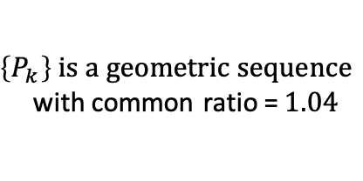
$$Amortization Table$$
$$i=0.04$$
Time $$k$$ | Payment $$C$$ | Interest Paid $$I_{k}$$ | Principal Repaid $$P_{k}$$ | Balance $$B_{k}$$
0 |  |  |  | 1000.00
1 | 275.49 | 40.00 | 235.49 | 764.51
2 | 275.49 | 30.58 | 244.91 | 519.60
3 | 275.49 | 20.78 | 254.71 | 264.89
4 | 275.49 | 10.60 | 264.89 | 0
$$\frac{244.91}{235.49}=1.04$$
$$\frac{254.71}{244.91}=1.04$$
$\left\{P_{k}\right\} is a geometric sequence$
with common ratio =$1.04$
$$\frac{264.89}{254.71}=1.04$$

Slide 36

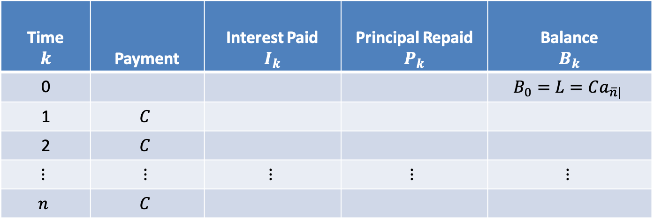
$$Level Payment Amortization Table$$
Time $$k$$ | Payment | Interest Paid $$I_{k}$$ | Principal Repaid $$P_{k}$$ | Balance $$B_{k}$$
0 |  |  |  | $$B_{0}=L=Ca_{\overline{n}|}$$
1 | $$C$$
2 | $$C$$
$$⋮$$ | $$⋮$$ | $$⋮$$ | $$⋮$$ | $$⋮$$
$$n$$ | $$C$$

Slide 37

$$Level Payment Amortization Table$$
Time $$k$$ | Payment | Interest Paid $$I_{k}$$ | Principal Repaid $$P_{k}$$ | Balance $$B_{k}$$
0 |  |  |  | $$B_{0}=L=Ca_{\overline{n}|}$$
1 | $$C$$
2 | $$C$$
$$⋮$$ | $$⋮$$ | $$⋮$$ | $$⋮$$ | $$⋮$$
$$n$$ | $$C$$
$$I_{1}=i∙B_{0}$$

Slide 38

$$Level Payment Amortization Table$$
Time $$k$$ | Payment | Interest Paid $$I_{k}$$ | Principal Repaid $$P_{k}$$ | Balance $$B_{k}$$
0 |  |  |  | $$B_{0}=L=Ca_{\overline{n}|}$$
1 | $$C$$
2 | $$C$$
$$⋮$$ | $$⋮$$ | $$⋮$$ | $$⋮$$ | $$⋮$$
$$n$$ | $$C$$
$$I_{1}=i∙B_{0}$$
$$=i∙Ca_{\overline{n}|}$$

Slide 39

$$Level Payment Amortization Table$$
Time $$k$$ | Payment | Interest Paid $$I_{k}$$ | Principal Repaid $$P_{k}$$ | Balance $$B_{k}$$
0 |  |  |  | $$B_{0}=L=Ca_{\overline{n}|}$$
1 | $$C$$
2 | $$C$$
$$⋮$$ | $$⋮$$ | $$⋮$$ | $$⋮$$ | $$⋮$$
$$n$$ | $$C$$
$$=i∙Ca_{\overline{n}|}$$
$$=i∙C∙\frac{1−v^{n}}{i}$$
$$I_{1}=i∙B_{0}$$

Slide 40

$$Level Payment Amortization Table$$
Time $$k$$ | Payment | Interest Paid $$I_{k}$$ | Principal Repaid $$P_{k}$$ | Balance $$B_{k}$$
0 |  |  |  | $$B_{0}=L=Ca_{\overline{n}|}$$
1 | $$C$$
2 | $$C$$
$$⋮$$ | $$⋮$$ | $$⋮$$ | $$⋮$$ | $$⋮$$
$$n$$ | $$C$$
$$=i∙Ca_{\overline{n}|}$$
$$=i∙C∙\frac{1−v^{n}}{i}$$
$$I_{1}=i∙B_{0}$$

Slide 41

$$Level Payment Amortization Table$$
Time $$k$$ | Payment | Interest Paid $$I_{k}$$ | Principal Repaid $$P_{k}$$ | Balance $$B_{k}$$
0 |  |  |  | $$B_{0}=L=Ca_{\overline{n}|}$$
1 | $$C$$
2 | $$C$$
$$⋮$$ | $$⋮$$ | $$⋮$$ | $$⋮$$ | $$⋮$$
$$n$$ | $$C$$
$$=i∙Ca_{\overline{n}|}$$
$$=i∙C∙\frac{1−v^{n}}{i}$$
$$I_{1}=i∙B_{0}$$
$$=C−C∙v^{n}$$

Slide 42
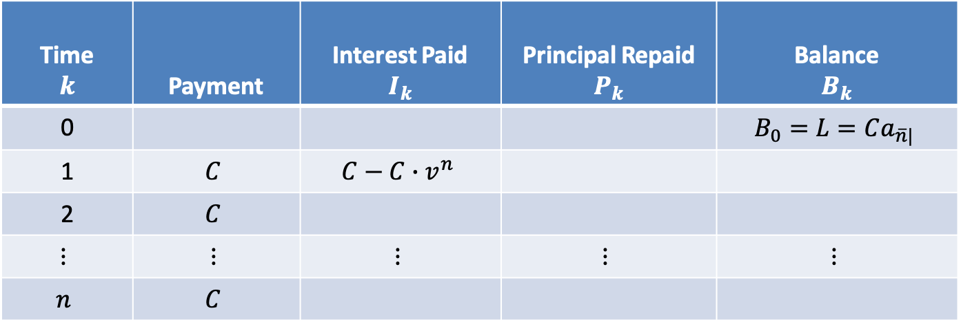
$$Level Payment Amortization Table$$
Time $$k$$ | Payment | Interest Paid $$I_{k}$$ | Principal Repaid $$P_{k}$$ | Balance $$B_{k}$$
0 |  |  |  | $$B_{0}=L=Ca_{\overline{n}|}$$
1 | $$C$$ | $$C−C∙v^{n}$$
2 | $$C$$
$$⋮$$ | $$⋮$$ | $$⋮$$ | $$⋮$$ | $$⋮$$
$$n$$ | $$C$$
$$=i∙Ca_{\overline{n}|}$$
$$=i∙C∙\frac{1−v^{n}}{i}$$
$$I_{1}=i∙B_{0}$$
$$=C−C∙v^{n}$$

Slide 43

$$Level Payment Amortization Table$$
Time $$k$$ | Payment | Interest Paid $$I_{k}$$ | Principal Repaid $$P_{k}$$ | Balance $$B_{k}$$
0 |  |  |  | $$B_{0}=L=Ca_{\overline{n}|}$$
1 | $$C$$ | $$C−C∙v^{n}$$
2 | $$C$$
$$⋮$$ | $$⋮$$ | $$⋮$$ | $$⋮$$ | $$⋮$$
$$n$$ | $$C$$
$$=i∙Ca_{\overline{n}|}$$
$$=i∙C∙\frac{1−v^{n}}{i}$$
$$I_{1}=i∙B_{0}$$
$$=C−C∙v^{n}$$
$$P_{1}=C−I_{1}$$

Slide 44

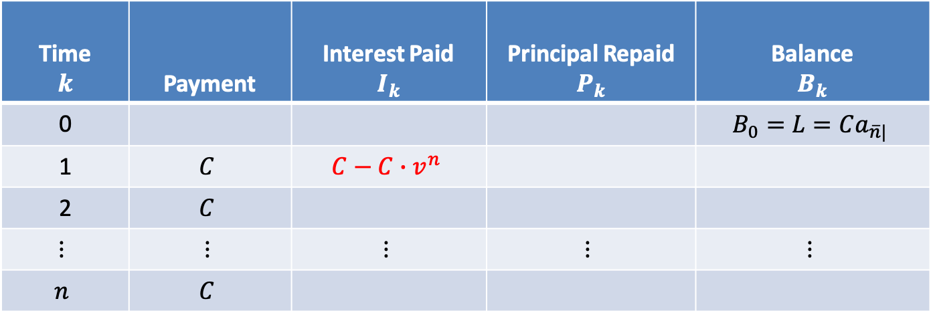

$$Level Payment Amortization Table$$
Time $$k$$ | Payment | Interest Paid $$I_{k}$$ | Principal Repaid $$P_{k}$$ | Balance $$B_{k}$$
0 |  |  |  | $$B_{0}=L=Ca_{\overline{n}|}$$
1 | $$C$$ | $$C−C∙v^{n}$$
2 | $$C$$
$$⋮$$ | $$⋮$$ | $$⋮$$ | $$⋮$$ | $$⋮$$
$$n$$ | $$C$$
$$=i∙Ca_{\overline{n}|}$$
$$=i∙C∙\frac{1−v^{n}}{i}$$
$$I_{1}=i∙B_{0}$$
$$=C−C∙v^{n}$$
$$P_{1}=C−I_{1}$$

Slide 45

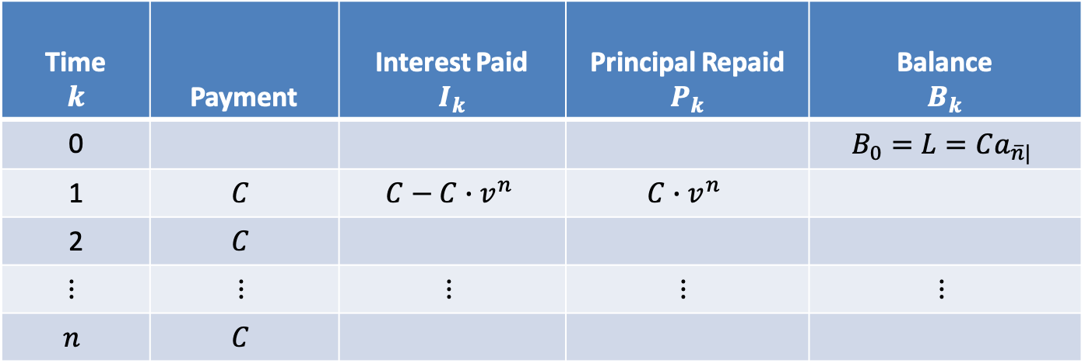
$$Level Payment Amortization Table$$
Time $$k$$ | Payment | Interest Paid $$I_{k}$$ | Principal Repaid $$P_{k}$$ | Balance $$B_{k}$$
0 |  |  |  | $$B_{0}=L=Ca_{\overline{n}|}$$
1 | $$C$$ | $$C−C∙v^{n}$$ | $$C∙v^{n}$$
2 | $$C$$
$$⋮$$ | $$⋮$$ | $$⋮$$ | $$⋮$$ | $$⋮$$
$$n$$ | $$C$$
$$=i∙Ca_{\overline{n}|}$$
$$=i∙C∙\frac{1−v^{n}}{i}$$
$$I_{1}=i∙B_{0}$$
$$=C−C∙v^{n}$$
$$P_{1}=C−I_{1}$$
$$=C∙v^{n}$$

Slide 46

$$Level Payment Amortization Table$$
Time $$k$$ | Payment | Interest Paid $$I_{k}$$ | Principal Repaid $$P_{k}$$ | Balance $$B_{k}$$
0 |  |  |  | $$B_{0}=L=Ca_{\overline{n}|}$$
1 | $$C$$ | $$C−C∙v^{n}$$ | $$C∙v^{n}$$
2 | $$C$$
$$⋮$$ | $$⋮$$ | $$⋮$$ | $$⋮$$ | $$⋮$$
$$n$$ | $$C$$
$$=i∙Ca_{\overline{n}|}$$
$$=i∙C∙\frac{1−v^{n}}{i}$$
$$I_{1}=i∙B_{0}$$
$$=C−C∙v^{n}$$
$$P_{1}=C−I_{1}$$
$$=C∙v^{n}$$
$$B_{1}=Ca_{\overline{n−1}|}$$

Slide 47
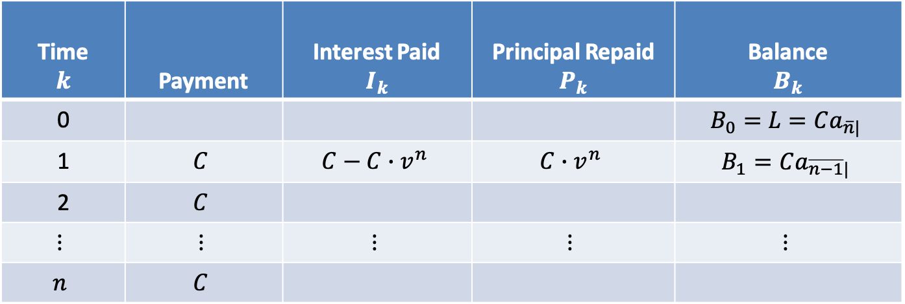
$$Level Payment Amortization Table$$
Time $$k$$ | Payment | Interest Paid $$I_{k}$$ | Principal Repaid $$P_{k}$$ | Balance $$B_{k}$$
0 |  |  |  | $$B_{0}=L=Ca_{\overline{n}|}$$
1 | $$C$$ | $$C−C∙v^{n}$$ | $$C∙v^{n}$$ | $$B_{1}=Ca_{\overline{n−1}|}$$
2 | $$C$$
$$⋮$$ | $$⋮$$ | $$⋮$$ | $$⋮$$ | $$⋮$$
$$n$$ | $$C$$
$$=i∙Ca_{\overline{n}|}$$
$$=i∙C∙\frac{1−v^{n}}{i}$$
$$I_{1}=i∙B_{0}$$
$$=C−C∙v^{n}$$
$$P_{1}=C−I_{1}$$
$$=C∙v^{n}$$
$$B_{1}=Ca_{\overline{n−1}|}$$

Slide 48

$$Level Payment Amortization Table$$
Time $$k$$ | Payment | Interest Paid $$I_{k}$$ | Principal Repaid $$P_{k}$$ | Balance $$B_{k}$$
0 |  |  |  | $$B_{0}=L=Ca_{\overline{n}|}$$
1 | $$C$$ | $$C−C∙v^{n}$$ | $$C∙v^{n}$$ | $$B_{1}=Ca_{\overline{n−1}|}$$
2 | $$C$$
$$⋮$$ | $$⋮$$ | $$⋮$$ | $$⋮$$ | $$⋮$$
$$n$$ | $$C$$
$$=i∙Ca_{\overline{n}|}$$
$$=i∙C∙\frac{1−v^{n}}{i}$$
$$I_{1}=i∙B_{0}$$
$$=C−C∙v^{n}$$
$$P_{1}=C−I_{1}$$
$$=C∙v^{n}$$
$$B_{1}=Ca_{\overline{n−1}|}$$
$$B_{1}=B_{0}−P_{1}$$

Slide 49

$$Level Payment Amortization Table$$
Time $$k$$ | Payment | Interest Paid $$I_{k}$$ | Principal Repaid $$P_{k}$$ | Balance $$B_{k}$$
0 |  |  |  | $$B_{0}=L=Ca_{\overline{n}|}$$
1 | $$C$$ | $$C−C∙v^{n}$$ | $$C∙v^{n}$$ | $$B_{1}=Ca_{\overline{n−1}|}$$
2 | $$C$$
$$⋮$$ | $$⋮$$ | $$⋮$$ | $$⋮$$ | $$⋮$$
$$n$$ | $$C$$
$$=i∙Ca_{\overline{n}|}$$
$$=i∙C∙\frac{1−v^{n}}{i}$$
$$I_{1}=i∙B_{0}$$
$$=C−C∙v^{n}$$
$$P_{1}=C−I_{1}$$
$$=C∙v^{n}$$
$$B_{1}=Ca_{\overline{n−1}|}$$
$$B_{1}=B_{0}−P_{1}$$
$$=Ca_{\overline{n}|}−C∙v^{n}$$

Slide 50

$$Level Payment Amortization Table$$
Time $$k$$ | Payment | Interest Paid $$I_{k}$$ | Principal Repaid $$P_{k}$$ | Balance $$B_{k}$$
0 |  |  |  | $$B_{0}=L=Ca_{\overline{n}|}$$
1 | $$C$$ | $$C−C∙v^{n}$$ | $$C∙v^{n}$$ | $$B_{1}=Ca_{\overline{n−1}|}$$
2 | $$C$$
$$⋮$$ | $$⋮$$ | $$⋮$$ | $$⋮$$ | $$⋮$$
$$n$$ | $$C$$
$$=i∙Ca_{\overline{n}|}$$
$$=i∙C∙\frac{1−v^{n}}{i}$$
$$I_{1}=i∙B_{0}$$
$$=C−C∙v^{n}$$
$$P_{1}=C−I_{1}$$
$$=C∙v^{n}$$
$$B_{1}=Ca_{\overline{n−1}|}$$
$$B_{1}=B_{0}−P_{1}$$
$$=Ca_{\overline{n}|}−C∙v^{n}$$
$$=C(v+v^{2}+⋯+v^{n})−C∙v^{n}$$

Slide 51

$$Level Payment Amortization Table$$
Time $$k$$ | Payment | Interest Paid $$I_{k}$$ | Principal Repaid $$P_{k}$$ | Balance $$B_{k}$$
0 |  |  |  | $$B_{0}=L=Ca_{\overline{n}|}$$
1 | $$C$$ | $$C−C∙v^{n}$$ | $$C∙v^{n}$$ | $$B_{1}=Ca_{\overline{n−1}|}$$
2 | $$C$$
$$⋮$$ | $$⋮$$ | $$⋮$$ | $$⋮$$ | $$⋮$$
$$n$$ | $$C$$
$$=i∙Ca_{\overline{n}|}$$
$$=i∙C∙\frac{1−v^{n}}{i}$$
$$I_{1}=i∙B_{0}$$
$$=C−C∙v^{n}$$
$$P_{1}=C−I_{1}$$
$$=C∙v^{n}$$
$$B_{1}=Ca_{\overline{n−1}|}$$
$$B_{1}=B_{0}−P_{1}$$
$$=Ca_{\overline{n}|}−C∙v^{n}$$
$$=C(v+v^{2}+⋯+v^{n})−C∙v^{n}$$

Slide 52

$$Level Payment Amortization Table$$
Time $$k$$ | Payment | Interest Paid $$I_{k}$$ | Principal Repaid $$P_{k}$$ | Balance $$B_{k}$$
0 |  |  |  | $$B_{0}=L=Ca_{\overline{n}|}$$
1 | $$C$$ | $$C−C∙v^{n}$$ | $$C∙v^{n}$$ | $$B_{1}=Ca_{\overline{n−1}|}$$
2 | $$C$$
$$⋮$$ | $$⋮$$ | $$⋮$$ | $$⋮$$ | $$⋮$$
$$n$$ | $$C$$
$$=i∙Ca_{\overline{n}|}$$
$$=i∙C∙\frac{1−v^{n}}{i}$$
$$I_{1}=i∙B_{0}$$
$$=C−C∙v^{n}$$
$$P_{1}=C−I_{1}$$
$$=C∙v^{n}$$
$$B_{1}=Ca_{\overline{n−1}|}$$
$$B_{1}=B_{0}−P_{1}$$
$$=Ca_{\overline{n}|}−C∙v^{n}$$
$$=C(v+v^{2}+⋯+v^{n})−C∙v^{n}$$
$$=C(v+v^{2}+⋯+v^{n−1})$$

Slide 53

$$Level Payment Amortization Table$$
Time $$k$$ | Payment | Interest Paid $$I_{k}$$ | Principal Repaid $$P_{k}$$ | Balance $$B_{k}$$
0 |  |  |  | $$B_{0}=L=Ca_{\overline{n}|}$$
1 | $$C$$ | $$C−C∙v^{n}$$ | $$C∙v^{n}$$ | $$B_{1}=Ca_{\overline{n−1}|}$$
2 | $$C$$
$$⋮$$ | $$⋮$$ | $$⋮$$ | $$⋮$$ | $$⋮$$
$$n$$ | $$C$$
$$=i∙Ca_{\overline{n}|}$$
$$=i∙C∙\frac{1−v^{n}}{i}$$
$$I_{1}=i∙B_{0}$$
$$=C−C∙v^{n}$$
$$P_{1}=C−I_{1}$$
$$=C∙v^{n}$$
$$B_{1}=Ca_{\overline{n−1}|}$$
$$B_{1}=B_{0}−P_{1}$$
$$=Ca_{\overline{n}|}−C∙v^{n}$$
$$=C(v+v^{2}+⋯+v^{n})−C∙v^{n}$$
$$=C(v+v^{2}+⋯+v^{n−1})$$
$$=Ca_{\overline{n−1}|}$$

Slide 54
$$Level Payment Amortization Table$$
Time $$k$$ | Payment | Interest Paid $$I_{k}$$ | Principal Repaid $$P_{k}$$ | Balance $$B_{k}$$
0 |  |  |  | $$B_{0}=L=Ca_{\overline{n}|}$$
1 | $$C$$ | $$C−C∙v^{n}$$ | $$C∙v^{n}$$ | $$B_{1}=Ca_{\overline{n−1}|}$$
2 | $$C$$
$$⋮$$ | $$⋮$$ | $$⋮$$ | $$⋮$$ | $$⋮$$
$$n$$ | $$C$$
$$=i∙Ca_{\overline{n}|}$$
$$=i∙C∙\frac{1−v^{n}}{i}$$
$$I_{1}=i∙B_{0}$$
$$=C−C∙v^{n}$$
$$P_{1}=C−I_{1}$$
$$=C∙v^{n}$$
$$B_{0}=Cv+Cv^{2}+⋯+Cv^{n−1}+Cv^{n}$$

Slide 55


$$Level Payment Amortization Table$$
Time $$k$$ | Payment | Interest Paid $$I_{k}$$ | Principal Repaid $$P_{k}$$ | Balance $$B_{k}$$
0 |  |  |  | $$B_{0}=L=Ca_{\overline{n}|}$$
1 | $$C$$ | $$C−C∙v^{n}$$ | $$C∙v^{n}$$ | $$B_{1}=Ca_{\overline{n−1}|}$$
2 | $$C$$
$$⋮$$ | $$⋮$$ | $$⋮$$ | $$⋮$$ | $$⋮$$
$$n$$ | $$C$$
$$=i∙Ca_{\overline{n}|}$$
$$=i∙C∙\frac{1−v^{n}}{i}$$
$$I_{1}=i∙B_{0}$$
$$=C−C∙v^{n}$$
$$P_{1}=C−I_{1}$$
$$=C∙v^{n}$$
$$B_{0}=Cv+Cv^{2}+⋯+Cv^{n−1}+Cv^{n}$$

Slide 56
$$Level Payment Amortization Table$$
Time $$k$$ | Payment | Interest Paid $$I_{k}$$ | Principal Repaid $$P_{k}$$ | Balance $$B_{k}$$
0 |  |  |  | $$B_{0}=L=Ca_{\overline{n}|}$$
1 | $$C$$ | $$C−C∙v^{n}$$ | $$C∙v^{n}$$ | $$B_{1}=Ca_{\overline{n−1}|}$$
2 | $$C$$
$$⋮$$ | $$⋮$$ | $$⋮$$ | $$⋮$$ | $$⋮$$
$$n$$ | $$C$$
$$=i∙Ca_{\overline{n}|}$$
$$=i∙C∙\frac{1−v^{n}}{i}$$
$$I_{1}=i∙B_{0}$$
$$=C−C∙v^{n}$$
$$P_{1}=C−I_{1}$$
$$=C∙v^{n}$$
$$B_{0}=Cv+Cv^{2}+⋯+Cv^{n−1}+Cv^{n}$$

Slide 57
$$Level Payment Amortization Table$$
Time $$k$$ | Payment | Interest Paid $$I_{k}$$ | Principal Repaid $$P_{k}$$ | Balance $$B_{k}$$
0 |  |  |  | $$B_{0}=L=Ca_{\overline{n}|}$$
1 | $$C$$ | $$C−C∙v^{n}$$ | $$C∙v^{n}$$ | $$B_{1}=Ca_{\overline{n−1}|}$$
2 | $$C$$
$$⋮$$ | $$⋮$$ | $$⋮$$ | $$⋮$$ | $$⋮$$
$$n$$ | $$C$$
$$=i∙Ca_{\overline{n}|}$$
$$=i∙C∙\frac{1−v^{n}}{i}$$
$$I_{1}=i∙B_{0}$$
$$=C−C∙v^{n}$$
$$P_{1}=C−I_{1}$$
$$=C∙v^{n}$$
$$B_{0}=Cv+Cv^{2}+⋯+Cv^{n−1}+Cv^{n}$$
$$B_{1}=Cv+Cv^{2}+⋯+Cv^{n−1}+Cv^{n}$$

Slide 58

$$Level Payment Amortization Table$$
Time $$k$$ | Payment | Interest Paid $$I_{k}$$ | Principal Repaid $$P_{k}$$ | Balance $$B_{k}$$
0 |  |  |  | $$B_{0}=L=Ca_{\overline{n}|}$$
1 | $$C$$ | $$C−C∙v^{n}$$ | $$C∙v^{n}$$ | $$B_{1}=Ca_{\overline{n−1}|}$$
2 | $$C$$
$$⋮$$ | $$⋮$$ | $$⋮$$ | $$⋮$$ | $$⋮$$
$$n$$ | $$C$$
$$=i∙Ca_{\overline{n}|}$$
$$=i∙C∙\frac{1−v^{n}}{i}$$
$$I_{1}=i∙B_{0}$$
$$=C−C∙v^{n}$$
$$P_{1}=C−I_{1}$$
$$=C∙v^{n}$$
$$B_{0}=Cv+Cv^{2}+⋯+Cv^{n−1}+Cv^{n}$$
$$B_{1}=Cv+Cv^{2}+⋯+Cv^{n−1}+Cv^{n}$$
$$=Ca_{\overline{n−1}|}$$

Slide 59
$$Level Payment Amortization Table$$
Time $$k$$ | Payment | Interest Paid $$I_{k}$$ | Principal Repaid $$P_{k}$$ | Balance $$B_{k}$$
0 |  |  |  | $$B_{0}=L=Ca_{\overline{n}|}$$
1 | $$C$$ | $$C−C∙v^{n}$$ | $$C∙v^{n}$$ | $$B_{1}=Ca_{\overline{n−1}|}$$
2 | $$C$$
$$⋮$$ | $$⋮$$ | $$⋮$$ | $$⋮$$ | $$⋮$$
$$n$$ | $$C$$

Slide 60

$$Level Payment Amortization Table$$
Time $$k$$ | Payment | Interest Paid $$I_{k}$$ | Principal Repaid $$P_{k}$$ | Balance $$B_{k}$$
0 |  |  |  | $$B_{0}=L=Ca_{\overline{n}|}$$
1 | $$C$$ | $$C−C∙v^{n}$$ | $$C∙v^{n}$$ | $$B_{1}=Ca_{\overline{n−1}|}$$
2 | $$C$$
$$⋮$$ | $$⋮$$ | $$⋮$$ | $$⋮$$ | $$⋮$$
$$n$$ | $$C$$
$$I_{2}=i∙B_{1}$$

Slide 61

$$Level Payment Amortization Table$$
Time $$k$$ | Payment | Interest Paid $$I_{k}$$ | Principal Repaid $$P_{k}$$ | Balance $$B_{k}$$
0 |  |  |  | $$B_{0}=L=Ca_{\overline{n}|}$$
1 | $$C$$ | $$C−C∙v^{n}$$ | $$C∙v^{n}$$ | $$B_{1}=Ca_{\overline{n−1}|}$$
2 | $$C$$
$$⋮$$ | $$⋮$$ | $$⋮$$ | $$⋮$$ | $$⋮$$
$$n$$ | $$C$$
$$I_{2}=i∙B_{1}$$
$$=i∙Ca_{\overline{n−1}|}$$

Slide 62

$$Level Payment Amortization Table$$
Time $$k$$ | Payment | Interest Paid $$I_{k}$$ | Principal Repaid $$P_{k}$$ | Balance $$B_{k}$$
0 |  |  |  | $$B_{0}=L=Ca_{\overline{n}|}$$
1 | $$C$$ | $$C−C∙v^{n}$$ | $$C∙v^{n}$$ | $$B_{1}=Ca_{\overline{n−1}|}$$
2 | $$C$$
$$⋮$$ | $$⋮$$ | $$⋮$$ | $$⋮$$ | $$⋮$$
$$n$$ | $$C$$
$$=i∙Ca_{\overline{n−1}|}$$
$$=i∙C∙\frac{1−v^{n−1}}{i}$$
$$I_{2}=i∙B_{1}$$

Slide 63

$$Level Payment Amortization Table$$
Time $$k$$ | Payment | Interest Paid $$I_{k}$$ | Principal Repaid $$P_{k}$$ | Balance $$B_{k}$$
0 |  |  |  | $$B_{0}=L=Ca_{\overline{n}|}$$
1 | $$C$$ | $$C−C∙v^{n}$$ | $$C∙v^{n}$$ | $$B_{1}=Ca_{\overline{n−1}|}$$
2 | $$C$$
$$⋮$$ | $$⋮$$ | $$⋮$$ | $$⋮$$ | $$⋮$$
$$n$$ | $$C$$
$$=i∙Ca_{\overline{n−1}|}$$
$$=i∙C∙\frac{1−v^{n−1}}{i}$$
$$I_{2}=i∙B_{1}$$

Slide 64

$$Level Payment Amortization Table$$
Time $$k$$ | Payment | Interest Paid $$I_{k}$$ | Principal Repaid $$P_{k}$$ | Balance $$B_{k}$$
0 |  |  |  | $$B_{0}=L=Ca_{\overline{n}|}$$
1 | $$C$$ | $$C−C∙v^{n}$$ | $$C∙v^{n}$$ | $$B_{1}=Ca_{\overline{n−1}|}$$
2 | $$C$$
$$⋮$$ | $$⋮$$ | $$⋮$$ | $$⋮$$ | $$⋮$$
$$n$$ | $$C$$
$$=i∙Ca_{\overline{n−1}|}$$
$$=i∙C∙\frac{1−v^{n−1}}{i}$$
$$I_{2}=i∙B_{1}$$
$$=C−C∙v^{n−1}$$

Slide 65
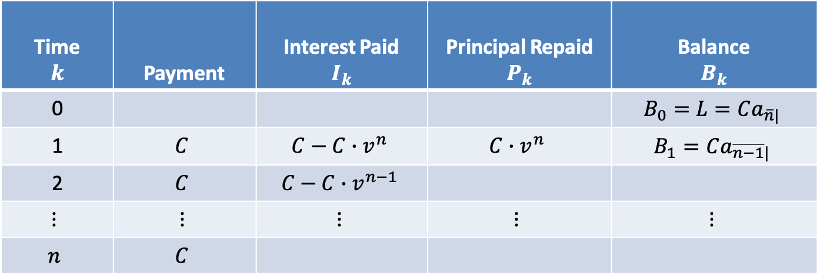
$$Level Payment Amortization Table$$
Time $$k$$ | Payment | Interest Paid $$I_{k}$$ | Principal Repaid $$P_{k}$$ | Balance $$B_{k}$$
0 |  |  |  | $$B_{0}=L=Ca_{\overline{n}|}$$
1 | $$C$$ | $$C−C∙v^{n}$$ | $$C∙v^{n}$$ | $$B_{1}=Ca_{\overline{n−1}|}$$
2 | $$C$$ | $$C−C∙v^{n−1}$$
$$⋮$$ | $$⋮$$ | $$⋮$$ | $$⋮$$ | $$⋮$$
$$n$$ | $$C$$
$$=i∙Ca_{\overline{n−1}|}$$
$$=i∙C∙\frac{1−v^{n−1}}{i}$$
$$I_{2}=i∙B_{1}$$
$$=C−C∙v^{n−1}$$

Slide 66

$$Level Payment Amortization Table$$
Time $$k$$ | Payment | Interest Paid $$I_{k}$$ | Principal Repaid $$P_{k}$$ | Balance $$B_{k}$$
0 |  |  |  | $$B_{0}=L=Ca_{\overline{n}|}$$
1 | $$C$$ | $$C−C∙v^{n}$$ | $$C∙v^{n}$$ | $$B_{1}=Ca_{\overline{n−1}|}$$
2 | $$C$$ | $$C−C∙v^{n−1}$$
$$⋮$$ | $$⋮$$ | $$⋮$$ | $$⋮$$ | $$⋮$$
$$n$$ | $$C$$
$$=i∙Ca_{\overline{n−1}|}$$
$$=i∙C∙\frac{1−v^{n−1}}{i}$$
$$I_{2}=i∙B_{1}$$
$$=C−C∙v^{n−1}$$
$$P_{2}=C−I_{2}$$

Slide 67

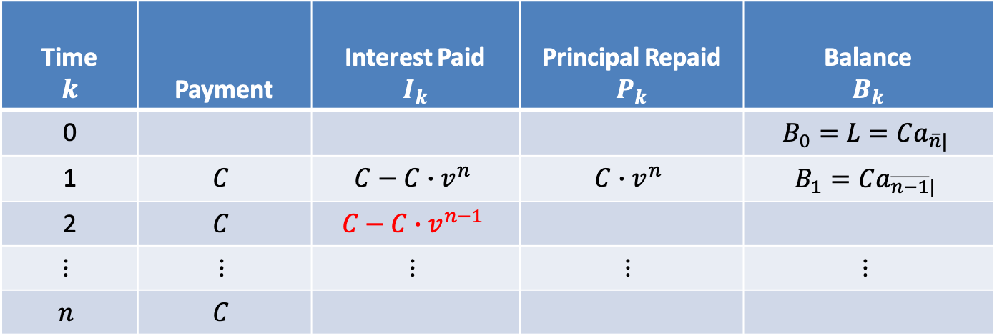

$$Level Payment Amortization Table$$
Time $$k$$ | Payment | Interest Paid $$I_{k}$$ | Principal Repaid $$P_{k}$$ | Balance $$B_{k}$$
0 |  |  |  | $$B_{0}=L=Ca_{\overline{n}|}$$
1 | $$C$$ | $$C−C∙v^{n}$$ | $$C∙v^{n}$$ | $$B_{1}=Ca_{\overline{n−1}|}$$
2 | $$C$$ | $$C−C∙v^{n−1}$$
$$⋮$$ | $$⋮$$ | $$⋮$$ | $$⋮$$ | $$⋮$$
$$n$$ | $$C$$
$$=i∙Ca_{\overline{n−1}|}$$
$$=i∙C∙\frac{1−v^{n−1}}{i}$$
$$I_{2}=i∙B_{1}$$
$$=C−C∙v^{n−1}$$
$$P_{2}=C−I_{2}$$

Slide 68

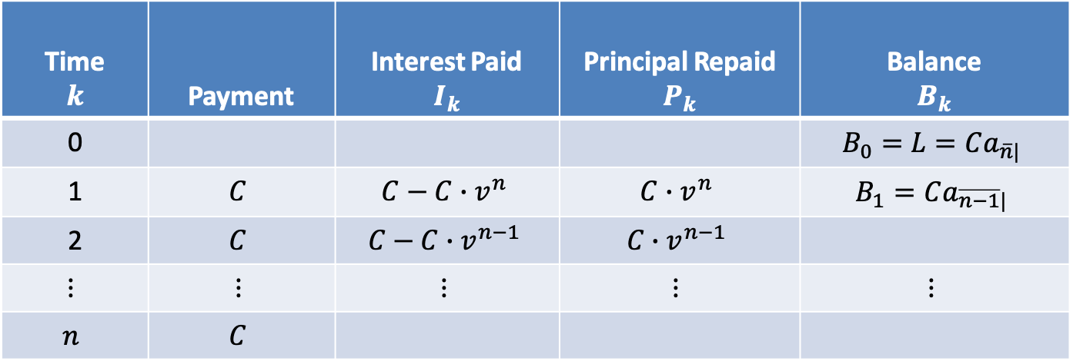
$$Level Payment Amortization Table$$
Time $$k$$ | Payment | Interest Paid $$I_{k}$$ | Principal Repaid $$P_{k}$$ | Balance $$B_{k}$$
0 |  |  |  | $$B_{0}=L=Ca_{\overline{n}|}$$
1 | $$C$$ | $$C−C∙v^{n}$$ | $$C∙v^{n}$$ | $$B_{1}=Ca_{\overline{n−1}|}$$
2 | $$C$$ | $$C−C∙v^{n−1}$$ | $$C∙v^{n−1}$$
$$⋮$$ | $$⋮$$ | $$⋮$$ | $$⋮$$ | $$⋮$$
$$n$$ | $$C$$
$$=i∙Ca_{\overline{n−1}|}$$
$$=i∙C∙\frac{1−v^{n−1}}{i}$$
$$I_{2}=i∙B_{1}$$
$$=C−C∙v^{n−1}$$
$$P_{2}=C−I_{2}$$
$$=C∙v^{n−1}$$

Slide 69

$$Level Payment Amortization Table$$
Time $$k$$ | Payment | Interest Paid $$I_{k}$$ | Principal Repaid $$P_{k}$$ | Balance $$B_{k}$$
0 |  |  |  | $$B_{0}=L=Ca_{\overline{n}|}$$
1 | $$C$$ | $$C−C∙v^{n}$$ | $$C∙v^{n}$$ | $$B_{1}=Ca_{\overline{n−1}|}$$
2 | $$C$$ | $$C−C∙v^{n−1}$$ | $$C∙v^{n−1}$$
$$⋮$$ | $$⋮$$ | $$⋮$$ | $$⋮$$ | $$⋮$$
$$n$$ | $$C$$
$$=i∙Ca_{\overline{n−1}|}$$
$$=i∙C∙\frac{1−v^{n−1}}{i}$$
$$I_{2}=i∙B_{1}$$
$$=C−C∙v^{n−1}$$
$$P_{2}=C−I_{2}$$
$$=C∙v^{n−1}$$
$$B_{2}=Ca_{\overline{n−2}|}$$

Slide 70
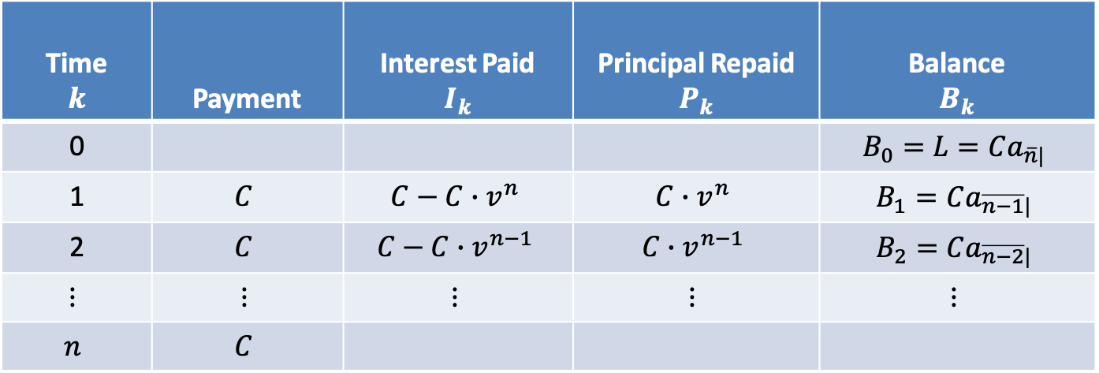
$$Level Payment Amortization Table$$
Time $$k$$ | Payment | Interest Paid $$I_{k}$$ | Principal Repaid $$P_{k}$$ | Balance $$B_{k}$$
0 |  |  |  | $$B_{0}=L=Ca_{\overline{n}|}$$
1 | $$C$$ | $$C−C∙v^{n}$$ | $$C∙v^{n}$$ | $$B_{1}=Ca_{\overline{n−1}|}$$
2 | $$C$$ | $$C−C∙v^{n−1}$$ | $$C∙v^{n−1}$$ | $$B_{2}=Ca_{\overline{n−2}|}$$
$$⋮$$ | $$⋮$$ | $$⋮$$ | $$⋮$$ | $$⋮$$
$$n$$ | $$C$$
$$=i∙Ca_{\overline{n−1}|}$$
$$=i∙C∙\frac{1−v^{n−1}}{i}$$
$$I_{2}=i∙B_{1}$$
$$=C−C∙v^{n−1}$$
$$P_{2}=C−I_{2}$$
$$=C∙v^{n−1}$$
$$B_{2}=Ca_{\overline{n−2}|}$$

Slide 71
$$Level Payment Amortization Table$$
Time $$k$$ | Payment | Interest Paid $$I_{k}$$ | Principal Repaid $$P_{k}$$ | Balance $$B_{k}$$
0 |  |  |  | $$B_{0}=L=Ca_{\overline{n}|}$$
1 | $$C$$ | $$C−C∙v^{n}$$ | $$C∙v^{n}$$ | $$B_{1}=Ca_{\overline{n−1}|}$$
2 | $$C$$ | $$C−C∙v^{n−1}$$ | $$C∙v^{n−1}$$ | $$B_{2}=Ca_{\overline{n−2}|}$$
$$⋮$$ | $$⋮$$ | $$⋮$$ | $$⋮$$ | $$⋮$$
$$n$$ | $$C$$

Slide 72

$$Level Payment Amortization Table$$
Time $$k$$ | Payment | Interest Paid $$I_{k}$$ | Principal Repaid $$P_{k}$$ | Balance $$B_{k}$$
0 |  |  |  | $$B_{0}=L=Ca_{\overline{n}|}$$
1 | $$C$$ | $$C−C∙v^{n}$$ | $$C∙v^{n}$$ | $$B_{1}=Ca_{\overline{n−1}|}$$
2 | $$C$$ | $$C−C∙v^{n−1}$$ | $$C∙v^{n−1}$$ | $$B_{2}=Ca_{\overline{n−2}|}$$
$$⋮$$ | $$⋮$$ | $$⋮$$ | $$⋮$$ | $$⋮$$
$$n$$ | $$C$$
$$I_{n}=i∙B_{n−1}$$

Slide 73

$$Level Payment Amortization Table$$
Time $$k$$ | Payment | Interest Paid $$I_{k}$$ | Principal Repaid $$P_{k}$$ | Balance $$B_{k}$$
0 |  |  |  | $$B_{0}=L=Ca_{\overline{n}|}$$
1 | $$C$$ | $$C−C∙v^{n}$$ | $$C∙v^{n}$$ | $$B_{1}=Ca_{\overline{n−1}|}$$
2 | $$C$$ | $$C−C∙v^{n−1}$$ | $$C∙v^{n−1}$$ | $$B_{2}=Ca_{\overline{n−2}|}$$
$$⋮$$ | $$⋮$$ | $$⋮$$ | $$⋮$$ | $$⋮$$
$$n$$ | $$C$$
$$I_{n}=i∙B_{n−1}$$
$$=i∙Ca_{\overline{1}|}$$

Slide 74

$$Level Payment Amortization Table$$
Time $$k$$ | Payment | Interest Paid $$I_{k}$$ | Principal Repaid $$P_{k}$$ | Balance $$B_{k}$$
0 |  |  |  | $$B_{0}=L=Ca_{\overline{n}|}$$
1 | $$C$$ | $$C−C∙v^{n}$$ | $$C∙v^{n}$$ | $$B_{1}=Ca_{\overline{n−1}|}$$
2 | $$C$$ | $$C−C∙v^{n−1}$$ | $$C∙v^{n−1}$$ | $$B_{2}=Ca_{\overline{n−2}|}$$
$$⋮$$ | $$⋮$$ | $$⋮$$ | $$⋮$$ | $$⋮$$
$$n$$ | $$C$$
$$=i∙Ca_{\overline{1}|}$$
$$=i∙C∙\frac{1−v}{i}$$
$$I_{n}=i∙B_{n−1}$$

Slide 75

$$Level Payment Amortization Table$$
Time $$k$$ | Payment | Interest Paid $$I_{k}$$ | Principal Repaid $$P_{k}$$ | Balance $$B_{k}$$
0 |  |  |  | $$B_{0}=L=Ca_{\overline{n}|}$$
1 | $$C$$ | $$C−C∙v^{n}$$ | $$C∙v^{n}$$ | $$B_{1}=Ca_{\overline{n−1}|}$$
2 | $$C$$ | $$C−C∙v^{n−1}$$ | $$C∙v^{n−1}$$ | $$B_{2}=Ca_{\overline{n−2}|}$$
$$⋮$$ | $$⋮$$ | $$⋮$$ | $$⋮$$ | $$⋮$$
$$n$$ | $$C$$
$$=i∙Ca_{\overline{1}|}$$
$$=i∙C∙\frac{1−v}{i}$$
$$I_{n}=i∙B_{n−1}$$

Slide 76

$$Level Payment Amortization Table$$
Time $$k$$ | Payment | Interest Paid $$I_{k}$$ | Principal Repaid $$P_{k}$$ | Balance $$B_{k}$$
0 |  |  |  | $$B_{0}=L=Ca_{\overline{n}|}$$
1 | $$C$$ | $$C−C∙v^{n}$$ | $$C∙v^{n}$$ | $$B_{1}=Ca_{\overline{n−1}|}$$
2 | $$C$$ | $$C−C∙v^{n−1}$$ | $$C∙v^{n−1}$$ | $$B_{2}=Ca_{\overline{n−2}|}$$
$$⋮$$ | $$⋮$$ | $$⋮$$ | $$⋮$$ | $$⋮$$
$$n$$ | $$C$$
$$=i∙Ca_{\overline{1}|}$$
$$=i∙C∙\frac{1−v}{i}$$
$$I_{n}=i∙B_{n−1}$$
$$=C−C∙v$$

Slide 77
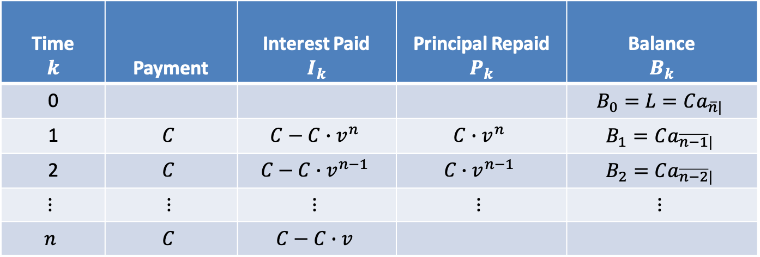
$$Level Payment Amortization Table$$
Time $$k$$ | Payment | Interest Paid $$I_{k}$$ | Principal Repaid $$P_{k}$$ | Balance $$B_{k}$$
0 |  |  |  | $$B_{0}=L=Ca_{\overline{n}|}$$
1 | $$C$$ | $$C−C∙v^{n}$$ | $$C∙v^{n}$$ | $$B_{1}=Ca_{\overline{n−1}|}$$
2 | $$C$$ | $$C−C∙v^{n−1}$$ | $$C∙v^{n−1}$$ | $$B_{2}=Ca_{\overline{n−2}|}$$
$$⋮$$ | $$⋮$$ | $$⋮$$ | $$⋮$$ | $$⋮$$
$$n$$ | $$C$$ | $$C−C∙v$$
$$=i∙Ca_{\overline{1}|}$$
$$=i∙C∙\frac{1−v}{i}$$
$$I_{n}=i∙B_{n−1}$$
$$=C−C∙v$$

Slide 78

$$Level Payment Amortization Table$$
Time $$k$$ | Payment | Interest Paid $$I_{k}$$ | Principal Repaid $$P_{k}$$ | Balance $$B_{k}$$
0 |  |  |  | $$B_{0}=L=Ca_{\overline{n}|}$$
1 | $$C$$ | $$C−C∙v^{n}$$ | $$C∙v^{n}$$ | $$B_{1}=Ca_{\overline{n−1}|}$$
2 | $$C$$ | $$C−C∙v^{n−1}$$ | $$C∙v^{n−1}$$ | $$B_{2}=Ca_{\overline{n−2}|}$$
$$⋮$$ | $$⋮$$ | $$⋮$$ | $$⋮$$ | $$⋮$$
$$n$$ | $$C$$ | $$C−C∙v$$
$$=i∙Ca_{\overline{1}|}$$
$$=i∙C∙\frac{1−v}{i}$$
$$I_{n}=i∙B_{n−1}$$
$$=C−C∙v$$
$$P_{n}=C−I_{n}$$

Slide 79

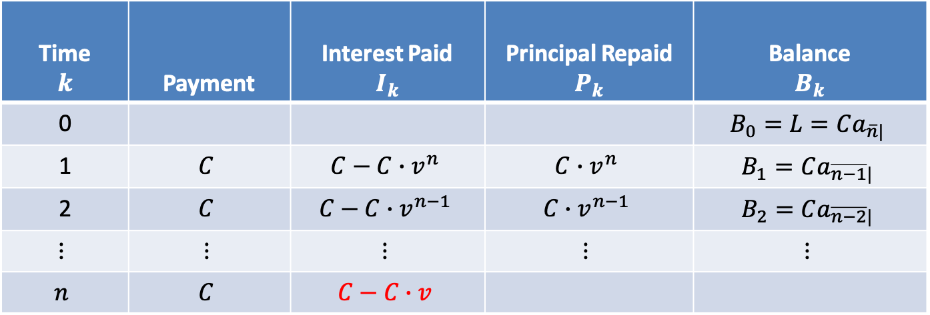

$$Level Payment Amortization Table$$
Time $$k$$ | Payment | Interest Paid $$I_{k}$$ | Principal Repaid $$P_{k}$$ | Balance $$B_{k}$$
0 |  |  |  | $$B_{0}=L=Ca_{\overline{n}|}$$
1 | $$C$$ | $$C−C∙v^{n}$$ | $$C∙v^{n}$$ | $$B_{1}=Ca_{\overline{n−1}|}$$
2 | $$C$$ | $$C−C∙v^{n−1}$$ | $$C∙v^{n−1}$$ | $$B_{2}=Ca_{\overline{n−2}|}$$
$$⋮$$ | $$⋮$$ | $$⋮$$ | $$⋮$$ | $$⋮$$
$$n$$ | $$C$$ | $$C−C∙v$$
$$=i∙Ca_{\overline{1}|}$$
$$=i∙C∙\frac{1−v}{i}$$
$$I_{n}=i∙B_{n−1}$$
$$=C−C∙v$$
$$P_{n}=C−I_{n}$$

Slide 80

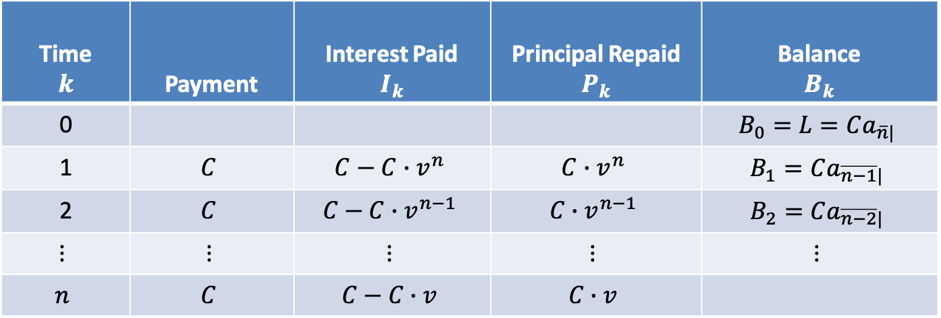
$$Level Payment Amortization Table$$
Time $$k$$ | Payment | Interest Paid $$I_{k}$$ | Principal Repaid $$P_{k}$$ | Balance $$B_{k}$$
0 |  |  |  | $$B_{0}=L=Ca_{\overline{n}|}$$
1 | $$C$$ | $$C−C∙v^{n}$$ | $$C∙v^{n}$$ | $$B_{1}=Ca_{\overline{n−1}|}$$
2 | $$C$$ | $$C−C∙v^{n−1}$$ | $$C∙v^{n−1}$$ | $$B_{2}=Ca_{\overline{n−2}|}$$
$$⋮$$ | $$⋮$$ | $$⋮$$ | $$⋮$$ | $$⋮$$
$$n$$ | $$C$$ | $$C−C∙v$$ | $$C∙v$$
$$=i∙Ca_{\overline{1}|}$$
$$=i∙C∙\frac{1−v}{i}$$
$$I_{n}=i∙B_{n−1}$$
$$=C−C∙v$$
$$P_{n}=C−I_{n}$$
$$=C∙v$$

Slide 81

$$Level Payment Amortization Table$$
Time $$k$$ | Payment | Interest Paid $$I_{k}$$ | Principal Repaid $$P_{k}$$ | Balance $$B_{k}$$
0 |  |  |  | $$B_{0}=L=Ca_{\overline{n}|}$$
1 | $$C$$ | $$C−C∙v^{n}$$ | $$C∙v^{n}$$ | $$B_{1}=Ca_{\overline{n−1}|}$$
2 | $$C$$ | $$C−C∙v^{n−1}$$ | $$C∙v^{n−1}$$ | $$B_{2}=Ca_{\overline{n−2}|}$$
$$⋮$$ | $$⋮$$ | $$⋮$$ | $$⋮$$ | $$⋮$$
$$n$$ | $$C$$ | $$C−C∙v$$ | $$C∙v$$
$$=i∙Ca_{\overline{1}|}$$
$$=i∙C∙\frac{1−v}{i}$$
$$I_{n}=i∙B_{n−1}$$
$$=C−C∙v$$
$$P_{n}=C−I_{n}$$
$$=C∙v$$
$$B_{n}=0$$

Slide 82
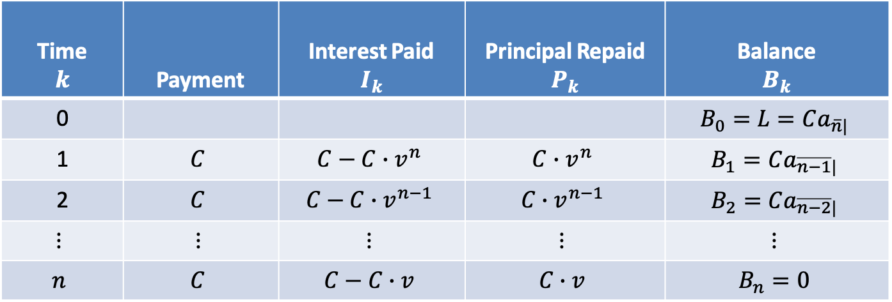
$$Level Payment Amortization Table$$
Time $$k$$ | Payment | Interest Paid $$I_{k}$$ | Principal Repaid $$P_{k}$$ | Balance $$B_{k}$$
0 |  |  |  | $$B_{0}=L=Ca_{\overline{n}|}$$
1 | $$C$$ | $$C−C∙v^{n}$$ | $$C∙v^{n}$$ | $$B_{1}=Ca_{\overline{n−1}|}$$
2 | $$C$$ | $$C−C∙v^{n−1}$$ | $$C∙v^{n−1}$$ | $$B_{2}=Ca_{\overline{n−2}|}$$
$$⋮$$ | $$⋮$$ | $$⋮$$ | $$⋮$$ | $$⋮$$
$$n$$ | $$C$$ | $$C−C∙v$$ | $$C∙v$$ | $$B_{n}=0$$
$$=i∙Ca_{\overline{1}|}$$
$$=i∙C∙\frac{1−v}{i}$$
$$I_{n}=i∙B_{n−1}$$
$$=C−C∙v$$
$$P_{n}=C−I_{n}$$
$$=C∙v$$
$$B_{n}=0$$

Slide 83
$$Level Payment Amortization Table$$
Time $$k$$ | Payment | Interest Paid $$I_{k}$$ | Principal Repaid $$P_{k}$$ | Balance $$B_{k}$$
0 |  |  |  | $$B_{0}=L=Ca_{\overline{n}|}$$
1 | $$C$$ | $$C−C∙v^{n}$$ | $$C∙v^{n}$$ | $$B_{1}=Ca_{\overline{n−1}|}$$
2 | $$C$$ | $$C−C∙v^{n−1}$$ | $$C∙v^{n−1}$$ | $$B_{2}=Ca_{\overline{n−2}|}$$
$$⋮$$ | $$⋮$$ | $$⋮$$ | $$⋮$$ | $$⋮$$
$$n$$ | $$C$$ | $$C−C∙v$$ | $$C∙v$$ | $$B_{n}=0$$

Slide 84

$$Level Payment Amortization Table$$
Time $$k$$ | Payment | Interest Paid $$I_{k}$$ | Principal Repaid $$P_{k}$$ | Balance $$B_{k}$$
0 |  |  |  | $$B_{0}=L=Ca_{\overline{n}|}$$
1 | $$C$$ | $$C−C∙v^{n}$$ | $$C∙v^{n}$$ | $$B_{1}=Ca_{\overline{n−1}|}$$
2 | $$C$$ | $$C−C∙v^{n−1}$$ | $$C∙v^{n−1}$$ | $$B_{2}=Ca_{\overline{n−2}|}$$
$$⋮$$ | $$⋮$$ | $$⋮$$ | $$⋮$$ | $$⋮$$
$$n$$ | $$C$$ | $$C−C∙v$$ | $$C∙v$$ | $$B_{n}=0$$
$$Remarks:$$

Slide 85
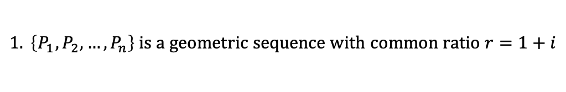
$$Level Payment Amortization Table$$
Time $$k$$ | Payment | Interest Paid $$I_{k}$$ | Principal Repaid $$P_{k}$$ | Balance $$B_{k}$$
0 |  |  |  | $$B_{0}=L=Ca_{\overline{n}|}$$
1 | $$C$$ | $$C−C∙v^{n}$$ | $$C∙v^{n}$$ | $$B_{1}=Ca_{\overline{n−1}|}$$
2 | $$C$$ | $$C−C∙v^{n−1}$$ | $$C∙v^{n−1}$$ | $$B_{2}=Ca_{\overline{n−2}|}$$
$$⋮$$ | $$⋮$$ | $$⋮$$ | $$⋮$$ | $$⋮$$
$$n$$ | $$C$$ | $$C−C∙v$$ | $$C∙v$$ | $$B_{n}=0$$
$$Remarks:$$
$$1. \left\{P_{1},P_{2},…,P_{n}\right\} is a geometric sequence with common ratio r=1+i$$

Slide 86

$$Level Payment Amortization Table$$
Time $$k$$ | Payment | Interest Paid $$I_{k}$$ | Principal Repaid $$P_{k}$$ | Balance $$B_{k}$$
0 |  |  |  | $$B_{0}=L=Ca_{\overline{n}|}$$
1 | $$C$$ | $$C−C∙v^{n}$$ | $$C∙v^{n}$$ | $$B_{1}=Ca_{\overline{n−1}|}$$
2 | $$C$$ | $$C−C∙v^{n−1}$$ | $$C∙v^{n−1}$$ | $$B_{2}=Ca_{\overline{n−2}|}$$
$$⋮$$ | $$⋮$$ | $$⋮$$ | $$⋮$$ | $$⋮$$
$$n$$ | $$C$$ | $$C−C∙v$$ | $$C∙v$$ | $$B_{n}=0$$
$$Remarks:$$
$$1. \left\{P_{1},P_{2},…,P_{n}\right\} is a geometric sequence with common ratio r=1+i$$
$$2. L=\sum{P_{k}}=P_{1}+P_{2}+…+P_{n}$$

Slide 87

$$Level Payment Amortization Table$$
Time $$k$$ | Payment | Interest Paid $$I_{k}$$ | Principal Repaid $$P_{k}$$ | Balance $$B_{k}$$
0 |  |  |  | $$B_{0}=L=Ca_{\overline{n}|}$$
1 | $$C$$ | $$C−C∙v^{n}$$ | $$C∙v^{n}$$ | $$B_{1}=Ca_{\overline{n−1}|}$$
2 | $$C$$ | $$C−C∙v^{n−1}$$ | $$C∙v^{n−1}$$ | $$B_{2}=Ca_{\overline{n−2}|}$$
$$⋮$$ | $$⋮$$ | $$⋮$$ | $$⋮$$ | $$⋮$$
$$n$$ | $$C$$ | $$C−C∙v$$ | $$C∙v$$ | $$B_{n}=0$$
$$Remarks:$$
$$1. \left\{P_{1},P_{2},…,P_{n}\right\} is a geometric sequence with common ratio r=1+i$$
$$2. L=\sum{P_{k}}=P_{1}+P_{2}+…+P_{n}$$
$$=P_{1}+P_{1}(1+i)+…+P_{1}{(1+i)}^{n−1}$$

Slide 88
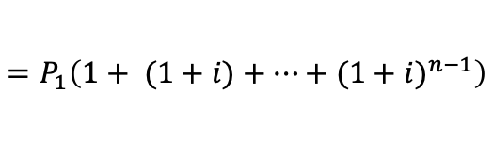
$$Level Payment Amortization Table$$
Time $$k$$ | Payment | Interest Paid $$I_{k}$$ | Principal Repaid $$P_{k}$$ | Balance $$B_{k}$$
0 |  |  |  | $$B_{0}=L=Ca_{\overline{n}|}$$
1 | $$C$$ | $$C−C∙v^{n}$$ | $$C∙v^{n}$$ | $$B_{1}=Ca_{\overline{n−1}|}$$
2 | $$C$$ | $$C−C∙v^{n−1}$$ | $$C∙v^{n−1}$$ | $$B_{2}=Ca_{\overline{n−2}|}$$
$$⋮$$ | $$⋮$$ | $$⋮$$ | $$⋮$$ | $$⋮$$
$$n$$ | $$C$$ | $$C−C∙v$$ | $$C∙v$$ | $$B_{n}=0$$
$$Remarks:$$
$$1. \left\{P_{1},P_{2},…,P_{n}\right\} is a geometric sequence with common ratio r=1+i$$
$$2. L=\sum{P_{k}}=P_{1}+P_{2}+…+P_{n}$$
$$=P_{1}\left(1+ (1+i)+…+{(1+i)}^{n−1}\right)$$

Slide 89

$$Level Payment Amortization Table$$
Time $$k$$ | Payment | Interest Paid $$I_{k}$$ | Principal Repaid $$P_{k}$$ | Balance $$B_{k}$$
0 |  |  |  | $$B_{0}=L=Ca_{\overline{n}|}$$
1 | $$C$$ | $$C−C∙v^{n}$$ | $$C∙v^{n}$$ | $$B_{1}=Ca_{\overline{n−1}|}$$
2 | $$C$$ | $$C−C∙v^{n−1}$$ | $$C∙v^{n−1}$$ | $$B_{2}=Ca_{\overline{n−2}|}$$
$$⋮$$ | $$⋮$$ | $$⋮$$ | $$⋮$$ | $$⋮$$
$$n$$ | $$C$$ | $$C−C∙v$$ | $$C∙v$$ | $$B_{n}=0$$
$$Remarks:$$
$$1. \left\{P_{1},P_{2},…,P_{n}\right\} is a geometric sequence with common ratio r=1+i$$
$$2. L=\sum{P_{k}}=P_{1}+P_{2}+…+P_{n}$$
$$=P_{1}\left(1+ (1+i)+…+{(1+i)}^{n−1}\right)$$
$$=P_{1}∙s_{\overline{n}|}$$

Slide 90

$$Level Payment Amortization Table$$
Time $$k$$ | Payment | Interest Paid $$I_{k}$$ | Principal Repaid $$P_{k}$$ | Balance $$B_{k}$$
0 |  |  |  | $$B_{0}=L=Ca_{\overline{n}|}$$
1 | $$C$$ | $$C−C∙v^{n}$$ | $$C∙v^{n}$$ | $$B_{1}=Ca_{\overline{n−1}|}$$
2 | $$C$$ | $$C−C∙v^{n−1}$$ | $$C∙v^{n−1}$$ | $$B_{2}=Ca_{\overline{n−2}|}$$
$$⋮$$ | $$⋮$$ | $$⋮$$ | $$⋮$$ | $$⋮$$
$$n$$ | $$C$$ | $$C−C∙v$$ | $$C∙v$$ | $$B_{n}=0$$
$$Remarks:$$
$$1. \left\{P_{1},P_{2},…,P_{n}\right\} is a geometric sequence with common ratio r=1+i$$
$$2. L=\sum{P_{k}}=P_{1}+P_{2}+…+P_{n}$$
$$=P_{1}\left(1+ (1+i)+…+{(1+i)}^{n−1}\right)$$
$$=P_{1}∙s_{\overline{n}|}$$
$$L=C∙a_{\overline{n}|}$$

Slide 91

$$Level Payment Amortization Table$$
Time $$k$$ | Payment | Interest Paid $$I_{k}$$ | Principal Repaid $$P_{k}$$ | Balance $$B_{k}$$
0 |  |  |  | $$B_{0}=L=Ca_{\overline{n}|}$$
1 | $$C$$ | $$C−C∙v^{n}$$ | $$C∙v^{n}$$ | $$B_{1}=Ca_{\overline{n−1}|}$$
2 | $$C$$ | $$C−C∙v^{n−1}$$ | $$C∙v^{n−1}$$ | $$B_{2}=Ca_{\overline{n−2}|}$$
$$⋮$$ | $$⋮$$ | $$⋮$$ | $$⋮$$ | $$⋮$$
$$n$$ | $$C$$ | $$C−C∙v$$ | $$C∙v$$ | $$B_{n}=0$$
$$Remarks:$$
$$1. \left\{P_{1},P_{2},…,P_{n}\right\} is a geometric sequence with common ratio r=1+i$$
$$2. L=\sum{P_{k}}=P_{1}+P_{2}+…+P_{n}$$
$$=P_{1}\left(1+ (1+i)+…+{(1+i)}^{n−1}\right)$$
$$=P_{1}∙s_{\overline{n}|}$$
$$L=C∙a_{\overline{n}|}$$
$$=C∙s_{\overline{n}|}∙v^{n}$$

Slide 92

$$Level Payment Amortization Table$$
Time $$k$$ | Payment | Interest Paid $$I_{k}$$ | Principal Repaid $$P_{k}$$ | Balance $$B_{k}$$
0 |  |  |  | $$B_{0}=L=Ca_{\overline{n}|}$$
1 | $$C$$ | $$C−C∙v^{n}$$ | $$C∙v^{n}$$ | $$B_{1}=Ca_{\overline{n−1}|}$$
2 | $$C$$ | $$C−C∙v^{n−1}$$ | $$C∙v^{n−1}$$ | $$B_{2}=Ca_{\overline{n−2}|}$$
$$⋮$$ | $$⋮$$ | $$⋮$$ | $$⋮$$ | $$⋮$$
$$n$$ | $$C$$ | $$C−C∙v$$ | $$C∙v$$ | $$B_{n}=0$$
$$Remarks:$$
$$1. \left\{P_{1},P_{2},…,P_{n}\right\} is a geometric sequence with common ratio r=1+i$$
$$2. L=\sum{P_{k}}=P_{1}+P_{2}+…+P_{n}$$
$$=P_{1}\left(1+ (1+i)+…+{(1+i)}^{n−1}\right)$$
$$=P_{1}∙s_{\overline{n}|}$$
$$L=C∙a_{\overline{n}|}$$
$$=C∙v^{n}∙s_{\overline{n}|}$$

Slide 93

$$Level Payment Amortization Table$$
Time $$k$$ | Payment | Interest Paid $$I_{k}$$ | Principal Repaid $$P_{k}$$ | Balance $$B_{k}$$
0 |  |  |  | $$B_{0}=L=Ca_{\overline{n}|}$$
1 | $$C$$ | $$C−C∙v^{n}$$ | $$C∙v^{n}$$ | $$B_{1}=Ca_{\overline{n−1}|}$$
2 | $$C$$ | $$C−C∙v^{n−1}$$ | $$C∙v^{n−1}$$ | $$B_{2}=Ca_{\overline{n−2}|}$$
$$⋮$$ | $$⋮$$ | $$⋮$$ | $$⋮$$ | $$⋮$$
$$n$$ | $$C$$ | $$C−C∙v$$ | $$C∙v$$ | $$B_{n}=0$$
$$Remarks:$$
$$1. \left\{P_{1},P_{2},…,P_{n}\right\} is a geometric sequence with common ratio r=1+i$$
$$2. L=\sum{P_{k}}=P_{1}+P_{2}+…+P_{n}$$
$$=P_{1}\left(1+ (1+i)+…+{(1+i)}^{n−1}\right)$$
$$=P_{1}∙s_{\overline{n}|}$$
$$L=C∙a_{\overline{n}|}$$
$$=C∙v^{n}∙s_{\overline{n}|}$$
$$=P_{1}∙s_{\overline{n}|}$$

Slide 94
$$Level Payment Amortization Table$$
Time $$k$$ | Payment | Interest Paid $$I_{k}$$ | Principal Repaid $$P_{k}$$ | Balance $$B_{k}$$
0 |  |  |  | $$B_{0}=L=Ca_{\overline{n}|}$$
1 | $$C$$ | $$C−C∙v^{n}$$ | $$C∙v^{n}$$ | $$B_{1}=Ca_{\overline{n−1}|}$$
2 | $$C$$ | $$C−C∙v^{n−1}$$ | $$C∙v^{n−1}$$ | $$B_{2}=Ca_{\overline{n−2}|}$$
$$⋮$$ | $$⋮$$ | $$⋮$$ | $$⋮$$ | $$⋮$$
$$n$$ | $$C$$ | $$C−C∙v$$ | $$C∙v$$ | $$B_{n}=0$$
$$Remarks:$$
$$1. \left\{P_{1},P_{2},…,P_{n}\right\} is a geometric sequence with common ratio r=1+i$$
$$2. L=\sum{P_{k}}=P_{1}+P_{2}+…+P_{n}$$
$$=P_{1}\left(1+ (1+i)+…+{(1+i)}^{n−1}\right)$$
$$=P_{1}∙s_{\overline{n}|}$$

Slide 95
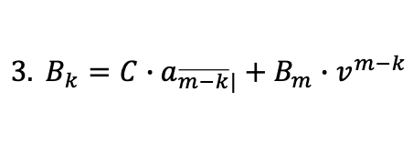
$$Level Payment Amortization Table$$
Time $$k$$ | Payment | Interest Paid $$I_{k}$$ | Principal Repaid $$P_{k}$$ | Balance $$B_{k}$$
0 |  |  |  | $$B_{0}=L=Ca_{\overline{n}|}$$
1 | $$C$$ | $$C−C∙v^{n}$$ | $$C∙v^{n}$$ | $$B_{1}=Ca_{\overline{n−1}|}$$
2 | $$C$$ | $$C−C∙v^{n−1}$$ | $$C∙v^{n−1}$$ | $$B_{2}=Ca_{\overline{n−2}|}$$
$$⋮$$ | $$⋮$$ | $$⋮$$ | $$⋮$$ | $$⋮$$
$$n$$ | $$C$$ | $$C−C∙v$$ | $$C∙v$$ | $$B_{n}=0$$
$$Remarks:$$
$$1. \left\{P_{1},P_{2},…,P_{n}\right\} is a geometric sequence with common ratio r=1+i$$
$$2. L=\sum{P_{k}}=P_{1}+P_{2}+…+P_{n}$$
$$=P_{1}\left(1+ (1+i)+…+{(1+i)}^{n−1}\right)$$
$$=P_{1}∙s_{\overline{n}|}$$
$$3. B_{k}=C∙a_{\overline{m−k}|}+B_{m}∙v^{m−k}$$

Slide 96
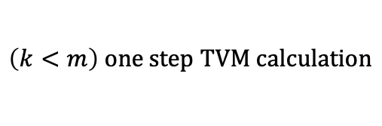
$$Level Payment Amortization Table$$
Time $$k$$ | Payment | Interest Paid $$I_{k}$$ | Principal Repaid $$P_{k}$$ | Balance $$B_{k}$$
0 |  |  |  | $$B_{0}=L=Ca_{\overline{n}|}$$
1 | $$C$$ | $$C−C∙v^{n}$$ | $$C∙v^{n}$$ | $$B_{1}=Ca_{\overline{n−1}|}$$
2 | $$C$$ | $$C−C∙v^{n−1}$$ | $$C∙v^{n−1}$$ | $$B_{2}=Ca_{\overline{n−2}|}$$
$$⋮$$ | $$⋮$$ | $$⋮$$ | $$⋮$$ | $$⋮$$
$$n$$ | $$C$$ | $$C−C∙v$$ | $$C∙v$$ | $$B_{n}=0$$
$$Remarks:$$
$$1. \left\{P_{1},P_{2},…,P_{n}\right\} is a geometric sequence with common ratio r=1+i$$
$$2. L=\sum{P_{k}}=P_{1}+P_{2}+…+P_{n}$$
$$=P_{1}\left(1+ (1+i)+…+{(1+i)}^{n−1}\right)$$
$$=P_{1}∙s_{\overline{n}|}$$
$$3. B_{k}=C∙a_{\overline{m−k}|}+B_{m}∙v^{m−k}$$
$$\left(k<m\right) one step TVM calculation$$

Slide 97
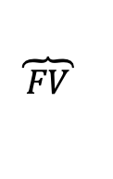
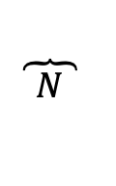
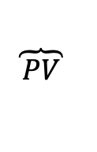
$$Level Payment Amortization Table$$
Time $$k$$ | Payment | Interest Paid $$I_{k}$$ | Principal Repaid $$P_{k}$$ | Balance $$B_{k}$$
0 |  |  |  | $$B_{0}=L=Ca_{\overline{n}|}$$
1 | $$C$$ | $$C−C∙v^{n}$$ | $$C∙v^{n}$$ | $$B_{1}=Ca_{\overline{n−1}|}$$
2 | $$C$$ | $$C−C∙v^{n−1}$$ | $$C∙v^{n−1}$$ | $$B_{2}=Ca_{\overline{n−2}|}$$
$$⋮$$ | $$⋮$$ | $$⋮$$ | $$⋮$$ | $$⋮$$
$$n$$ | $$C$$ | $$C−C∙v$$ | $$C∙v$$ | $$B_{n}=0$$
$$Remarks:$$
$$1. \left\{P_{1},P_{2},…,P_{n}\right\} is a geometric sequence with common ratio r=1+i$$
$$2. L=\sum{P_{k}}=P_{1}+P_{2}+…+P_{n}$$
$$=P_{1}\left(1+ (1+i)+…+{(1+i)}^{n−1}\right)$$
$$=P_{1}∙s_{\overline{n}|}$$
$$3. B_{k}=C∙a_{\overline{m−k}|}+B_{m}∙v^{m−k}$$
$$\left(k<m\right) one step TVM calculation$$
$$\overbrace{ PV }$$
$$\overbrace{ N }$$
$$\overbrace{ FV }$$

